Slide 1

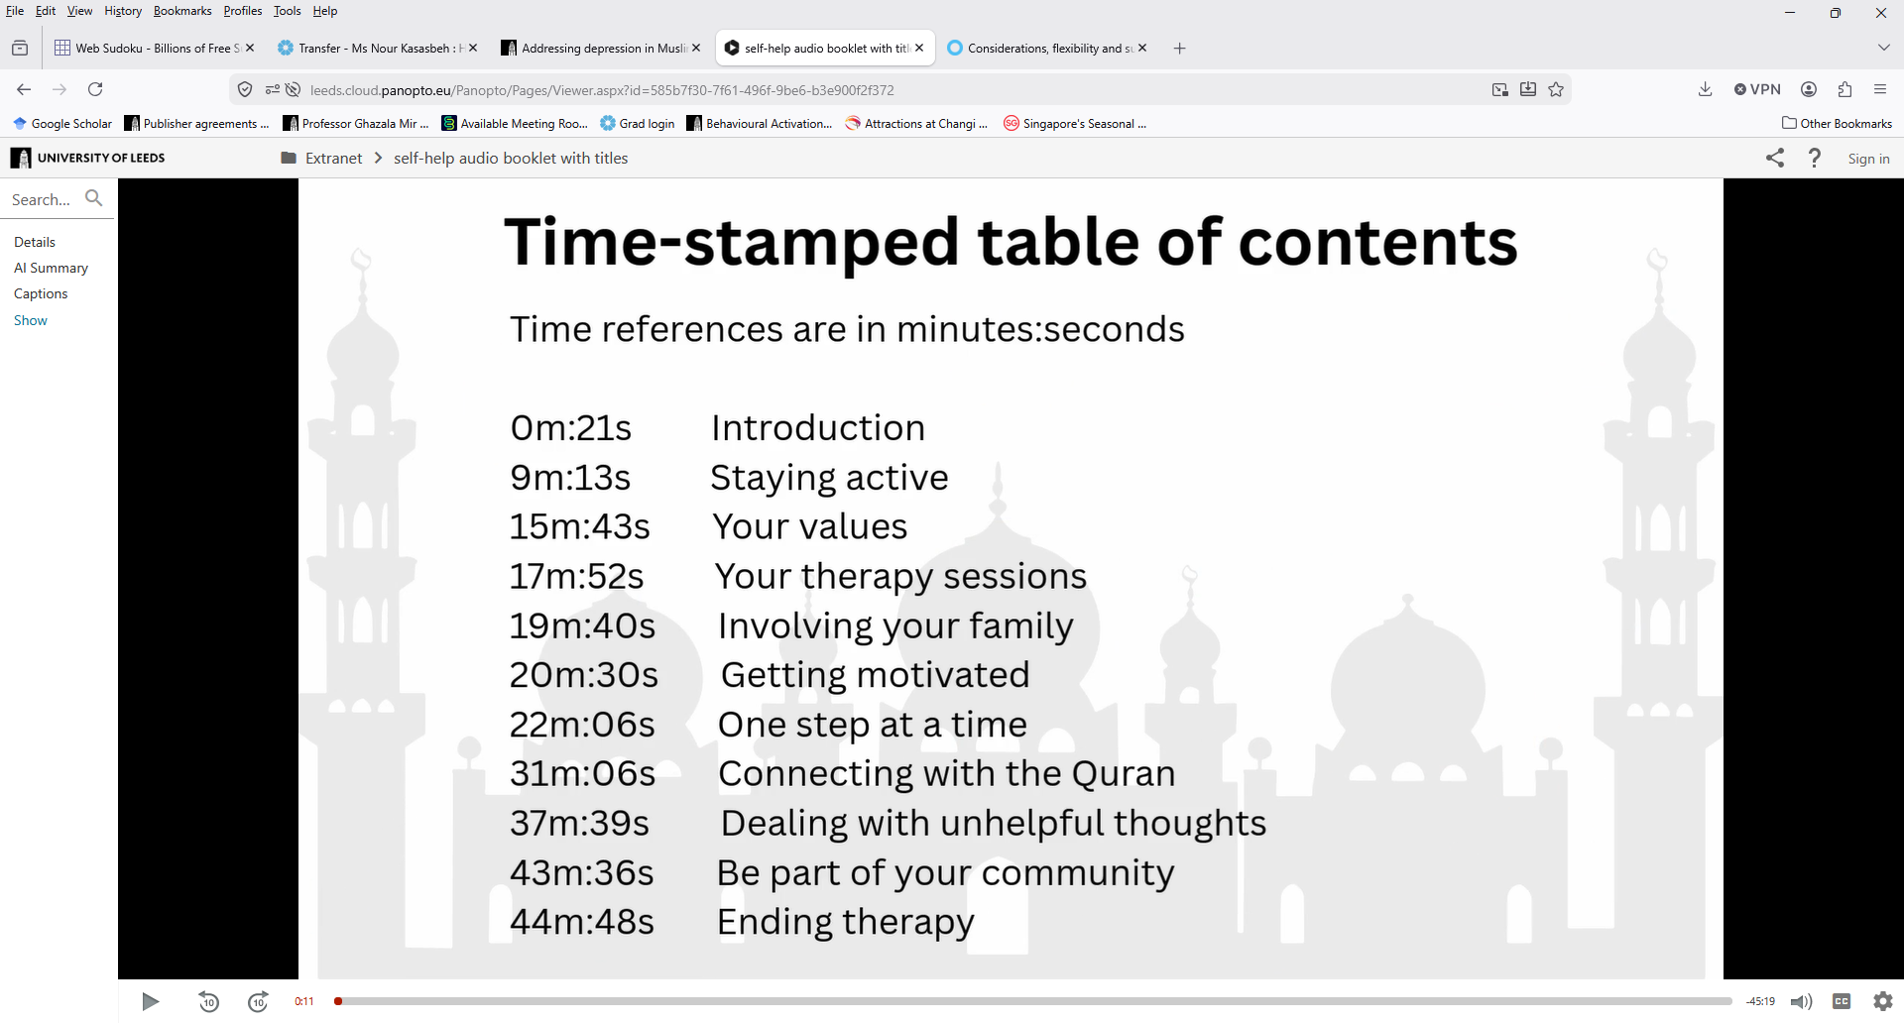
An audio version of the self-help booklet for Muslims is available at this link.
You can go directly to the different sections in the booklet using the time references in the next box.

