Slide 1
Welcome to the
School of Healthcare
Social Work Pre-event preparation
11th in the UK for Social Work
The Times & Sunday Times league tables 2021
5th in Yorkshire and the Humber for Social work
The Complete University Guide 2022
Notes:
We are a very popular School we attract over 5000 applications a year.
We are a School of Healthcare not of Nursing and also provide courses in radiography, midwifery, audiology and social work.

Slide 2
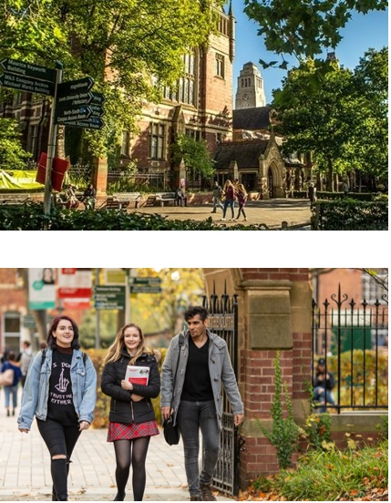
About our University and School
11th in the UK for Social Work - The Times & Sunday Times league tables 2021.
‘World leading’ research – unique learning from respected academics.
The University of Leeds is among the top 100 universities in the World – QS World University Rankings 2021.
The University of Leeds is 9th in the UK for graduate recruitment - High Fliers Research, 2019.
Notes:
At the start of the presentation make people aware that :
No planned fire drills, therefore please respond to any emergency alarm.
Show the location of fire exits at the start of each talk/activity.

Slide 3
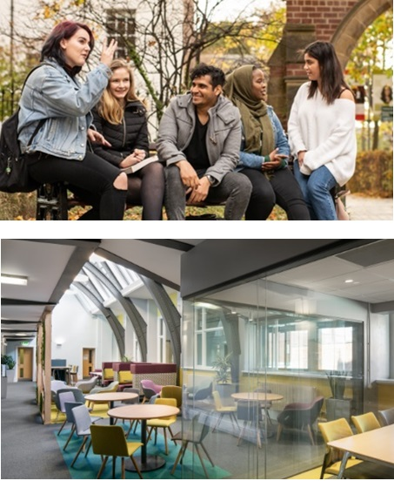
A great student experience
Support from personal tutors, programme managers, peers.
Excellent local practice experience.
Great facilities – student zones, clinical skills facilities, fully furnished flat with lounge, kitchen, bathroom and bedroom.
Notes:
At the start of the presentation make people aware that :
No planned fire drills, therefore please respond to any emergency alarm.
Show the location of fire exits at the start of each talk/activity.

Slide 4
Influential, inspirational staff
The social work team has a wealth of experience, expertise and knowledge to support your degree experience.
Iain Moody Background in statutory and voluntary sector child and family social work.
Dr David Saltiel
Presented research about decision making in child and family social work at national conferences.
Ros Day
Background in teaching schools, FE and HE. Teaches Sociology, Social Policy and is a personal tutor.

Slide 5
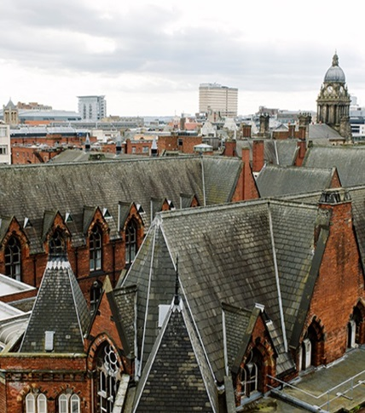
Selection
Short listing from UCAS forms: academic criteria/personal statement/references.
Interviews: academic staff and service users/carers (January 2021 until March 2022).
DBS check: you must declare everything, no matter what you have been told in the past.
Non-declaration may be enough to be refused entry onto the programme.
Kathryn Waldegrave –Personal Tutor of the Year 2018/19

Slide 6
BA in Social Work
Professional qualification
Academic
Linking theory to research and practice
Becoming a reflective practitioner
Generic social work qualification covering all aspects of social work.

Slide 7
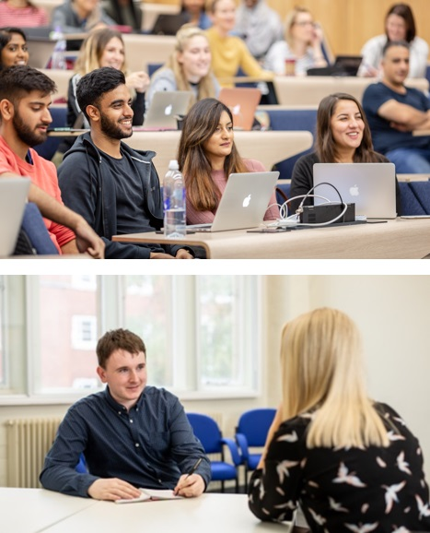
Year 1
Semester 1: approx. 3 ½ days per week + private study 9.30 until 4.30 in (some recall days/special sessions).
Semester 2: approx. 3 ½ days per week preparation for placement + placement.
All modules in year 1 compulsory.

Slide 8
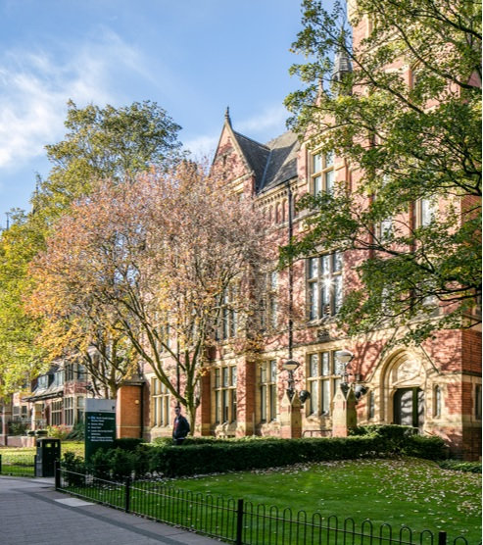
A period of change
Social Work England https://www.socialworkengland.org.uk
Social work education and training are currently being reviewed.
Social Work Bursary agreed (Year 2 & 3).
Not all students will receive a bursary (42 available).

Slide 9
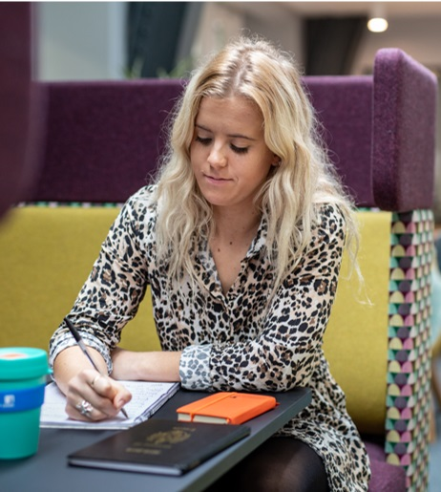
Social Work bursary
Currently 42 bursaries available.
If eligible all students will receive a bursary (up to 42 students).

Slide 10
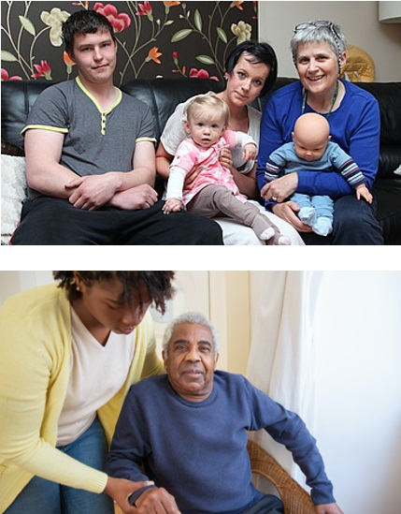
Professional Capabilities framework
Professional training for social work/Social Work England.
Common induction standards/skills for care.

Slide 11
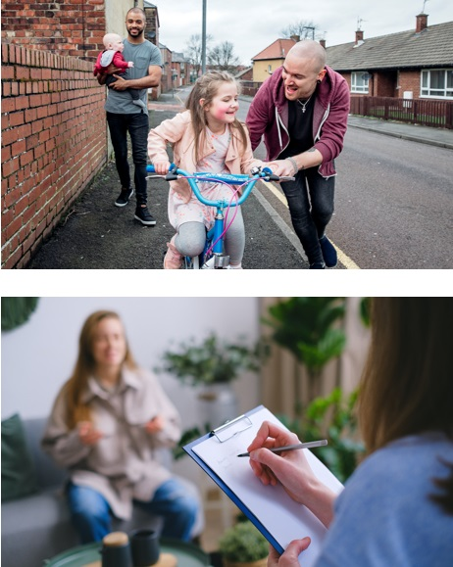
Professional regulation
Health Professionals Council (from 2012).
Health and Care Professionals Council.
Regulation is necessary to protect service users and to maintain professional standards.

Slide 12
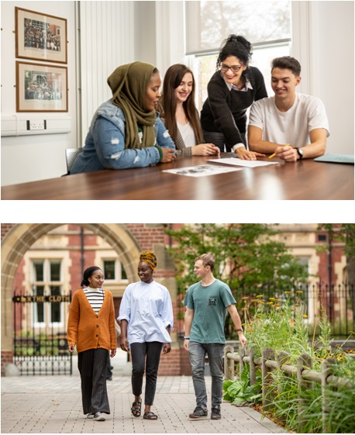
Social care institute for excellence
We gather and analyse knowledge about what works and translate that knowledge into practical resources, learning materials and services.
This helps to improve the knowledge and skills of those working in care services. This includes managers, frontline staff, people and their families who use these services also use our resources.
http://www.scie.org.uk

Slide 13
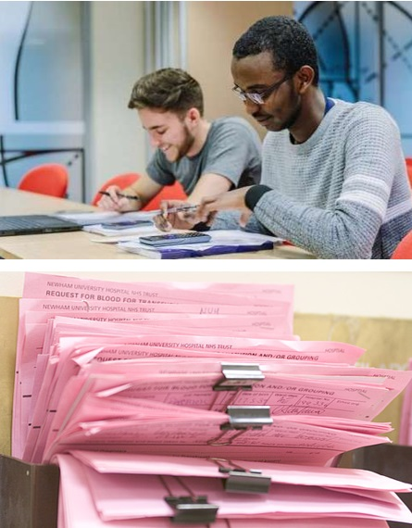
Assessment (formative and summative)
Variety
Assignments
Exams
Presentations
Role plays
Dissertation (year 3).

Slide 14
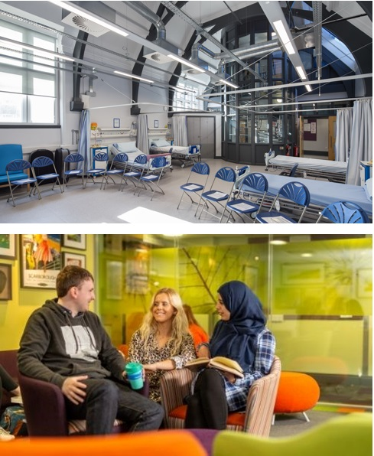
Placements
The duration of placements and preparation for placements is changing to 170 days.
Depending upon the new partnership arrangements there are likely to be 2 statutory placements: 70 days in year 2 and 100 days in year 3.
Teaching partnerships with Leeds and Wakefield.
Cost of travel to/from placement.

Slide 15
Can you drive?
In most statutory placements it is essential to have a car.

Slide 16
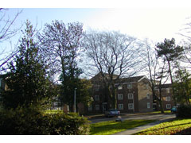
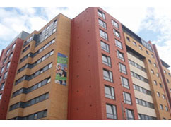
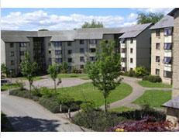
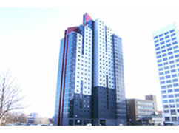
Accommodation
First years are guaranteed accommodation.
All are close to the city, University and close to placements.
All are self catering, & longer booking for healthcare students 45 week term.
Accommodation.leeds.ac.uk
www.unitestudents.com/leeds
10 mins from Uni
20 mins from Uni
Lupton Flats
The Tannery
20 mins from Uni
15 mins from Uni
Oxley halls
Opal 3
Notes:
All these student accommodation are close by – Opal 3 is about 800 yards down towards the Merrion centre, the Tannery is on Kirkstall Rd close to the Leeds General Infirmary, both 2 minutes from the city centre
Lupton and Oxley are a few miles up the road in Headingley, which has bars, restaurants a cinema and supermarkets close by (and home of the famous cricket ground). All have a short bus to and from the University.
These places are all self catering and open throughout the summer; this is because when on practice, you would miss the fixed mealtimes and there will still be fellow students around after June.

Slide 17
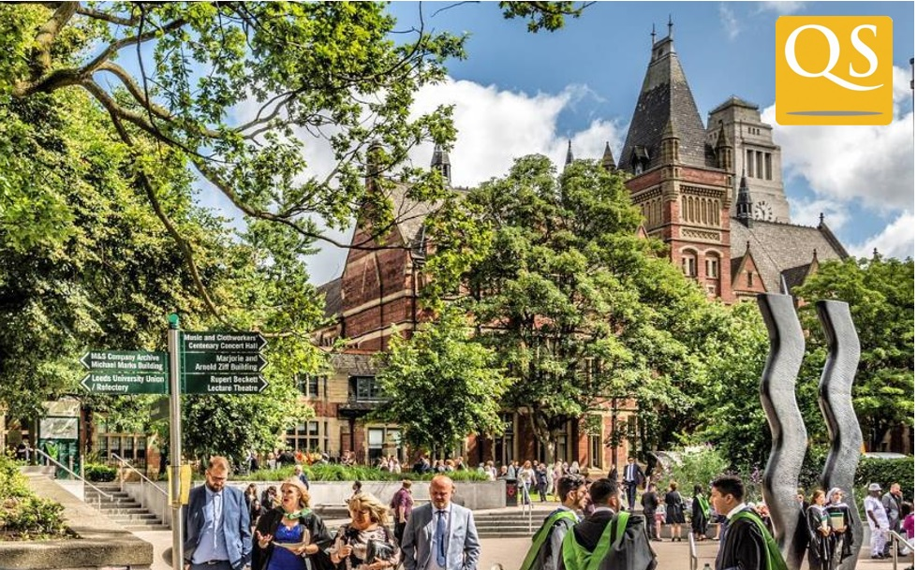
University of Leeds
Established in 1831 with School of Medicine.
Home to over 35,000 students.
Reputation for excellence in research and teaching (top 10 in the UK).
90% student satisfaction.
Voted best student destination (The Independent).
Voted most cost-effective student city.
Notes:
Now onto the University….
we are a one of the largest Universities in the UK, over 35k students and founded as I mentioned, here in 1831.
Our Research reputation is globally recognised and we work on major challenges such as global warming, food shortages and medical treatments.
Leeds is a popular city and was voted best student destination by The Independent last year; maybe because its a fairly cheap to live – it was the most cost effective city a few years ago and you can make your money go a long way if you’re careful with it!

Slide 18
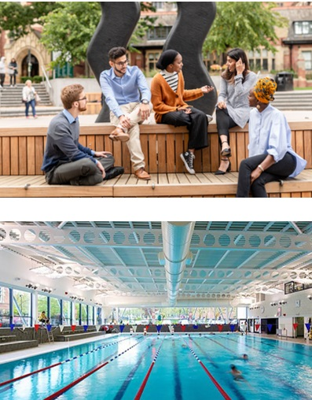
A great student experience
A vibrant campus, The ‘Edge’ sports facilities, gig and club venues, over 300 societies, minutes from the city centre.
First students’ union in the UK to be awarded “excellent” status by National Union of Students (NUS).
Shopping, Leeds Festivals, nightlife, Opera North, West Yorkshire Playhouse, First Direct Arena, Leeds United!
Close to the countryside – Yorkshire Dales, Whitby, Scarborough.
Notes:
The Union is a place you will be spending some of your time in if you choose Leeds. It’s another award winner – voted best student union in the UK last year, probably because its run by students for students.
There are over 200 societies, Archery, Belly dancing, Circus skills, Horse Riding, Stitch and Bitch(crocheting and knitting), shopaholics and wilderness medicine – check out the LUU website!
We have award winning bars, our own theatres, cinemas, nightclubs and music venues within 200 yards of this building, but don’t take my word, have a look around for yourself after the presentation.
We continue to improve our central services so you have a great student experience with us:
We’ve just opened The Edge, a £12 million swimming and fitness centre which includes a new pool, massive fitness centre, indoor courts, outdoor all weather pitches and our own climbing wall. All the machines take an ipod and your can link your own personal fitness programmes and progress via the web, it matches any of the private gyms in the area..
Our personal tutoring programme Leeds for Life will help start build your career while you are with us. The Leeds model for personal tutoring will give you structured one-to-one meetings with your personal tutor throughout your degree. These meetings will support your professional and academic development, helping you to become a confident, articulate Leeds graduate. And you can seek funding and advice for your business ideas.
We have our own Leeds Student Medical Practice – 16 doctors, practice nurses 2 minutes away, to keep you healthy while you are with us.
And we have an award-winning £16 million Student Services Centre, the Ziff Building, where you’ll go for student ID, certificates, fees, funding scholarships.

Slide 19
A great city and region
Great Shopping, Harvey Nicholls, Louis Vuitton, All Saints, Trinity, new Victoria Gate, COS, John Lewis, Primark.
Great nightlife, clubs, bars, cafes, Leeds Fest; Opera North, West Yorkshire Playhouse, First Direct Arena
Great to relax: Close to the countryside, Ilkley moor, Betty’s Harrogate, seaside at Whitby, Scarborough, Filey.
Notes:
Leeds is the UK’s third largest city, with a population of 724,000, yet has a compact, easily walkable city centre,
You will know about the Leeds Festivals, Opera North and of course the outstanding nightlife we have here in in the city.
It’s also been voted the UK’s most popular city and is one of the greenest, with parks and quiet squares to relax in.
Leeds people like the place – and 94% feel proud to live here; we hope you will too. Many of our students like it so much they stay here!
The beauty of studying in Leeds is that you are just a few miles to the beautiful countryside of Yorkshire, with its inspiring moorlands and stunning coastlines. It’s a great place to go by train, bus or car to recharge your batteries and relax after studying or work.
It’s no surprise to us that North Yorkshire has been voted the Garden of England, we have raw beauty, stately opulence, seaside experience or history and tradition on our doorstep, when you come to study with us.

Slide 20
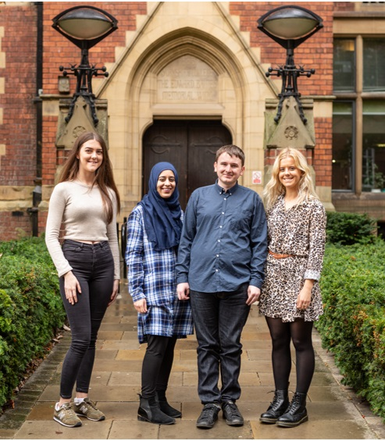
Why study at Leeds?
The best University.
The best School.
The best city.
The best degree experience.
Notes:
So why study with us at Leeds?
We believe we have the best school – we’ve talked about the great facilities, inspirational staff and unique learning, at the heart of the university.
And we have the best City –a vibrant culture, great nightlife, shops, the countryside on your doorstep and your money goes further.
and finally, we believe we have the best degree experience:
What you learn at Leeds that you won’t learn anywhere else. You’ll meet world leading research academics, work in the best hospitals, and be supported in every aspect of your education with us to graduation and in your professional life as part of our alumni family.
You are the start of an incredible journey which will change your life .
We hope you choose to make that journey here at the School of Healthcare and make us your first choice.
Thank you.

