Slide 1
Pilot Project Myanmar
Rosemary Kabaki (Nonviolent Peaceforce) and Rachel Julian (Leeds Beckett University)

Slide 2
Participatory Action Research with Emerging Women Leaders in Myanmar
The research methodology is a feminist participatory approach which values the experiential knowledge of those experiencing the multiple threats
It recognises the capacity of those currently excluded from participating to gather and share that knowledge.
We take an intersectional view of disadvantage, recognising that it is not only gender, ethnicity, disability, and age, but often a combination

Slide 3
Our project will enable the women to do their own micro-research project which will;
a) provide details on needs and inequalities within the context that could not be generated by ‘outsiders’
b) give the women credibility as participants in local and national processes by presenting data they have generated, and
c) build the skills of the women on how research helps them achieve their aims of participation.
We will do this by running a participatory training and development intervention in which the women design and do their research projects.

Slide 4
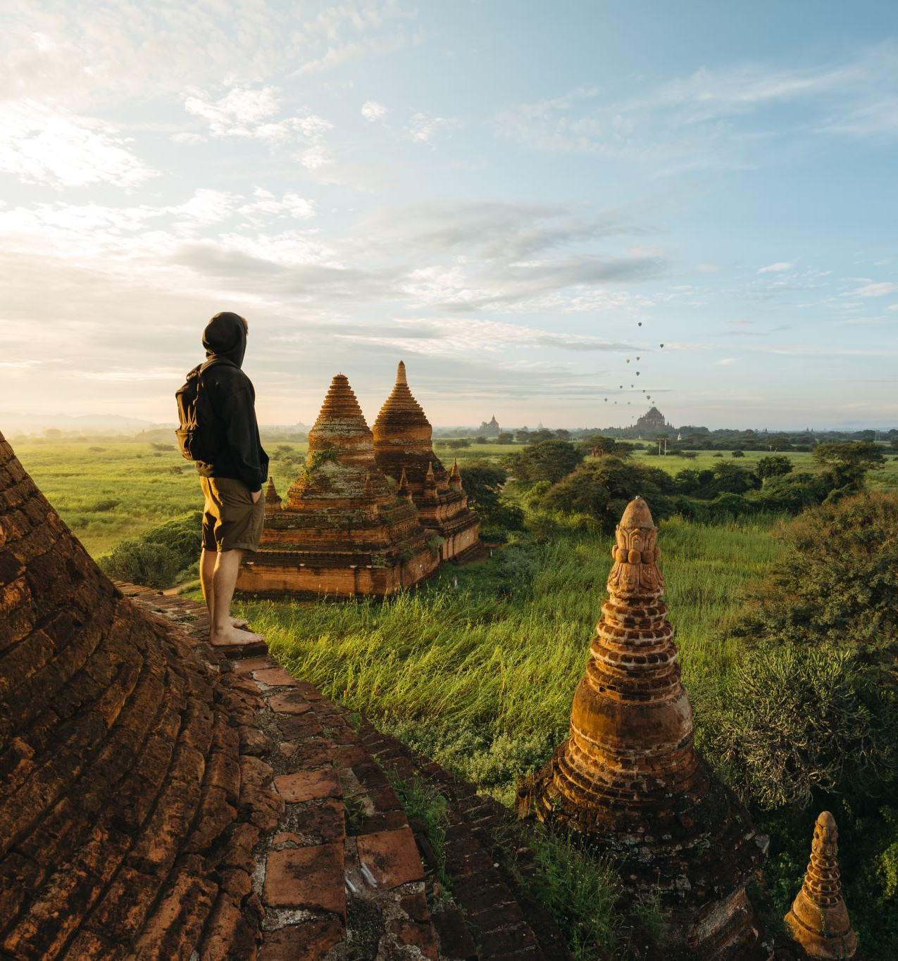
The overarching research question is
‘what are biggest challenges women face in building peaceful future, where peace means safety, equality, health, education and livelihood?’

Slide 5
how
We will answer this question through the 10 small research projects that the women design in small groups.
After the training and design, the women had 3 months to collect data (using observation, narrative, or remote interview)
We will then have rich, diverse data from inside the excluded communities.

Slide 6
Theory of change
If we train emerging women leaders to gather evidence and ask the important questions no-one is asking about their lives and their communities, then their credibility will increase and they will have more chance of being heard by the people already making decisions along the themes (safety, inequality, health, education) mentioned above. If those women ask the other women, and train them in basic research skills, then those women can become the next rising set of emerging women leaders able to gather and present data and influence decision making within their own communities (environment, land) and national (education and health).

Slide 7
Challenges we faced
Covid restrictions – we planned the research design to allow for this
February military coup
The policy access and more experienced women are now not available

Slide 8
Key finding
What are biggest challenges women face in building peaceful future, where peace means safety, equality, health, education and livelihood?
Discriminatory customary law undermining women’s rights in Paletwa, Chin State

Slide 9
Customary law has great impact on the private sphere of women from Paletwa. In that regard, the data collected by the researchers from Paletwa shows that some customary law provisions affect women’s ability to enjoy their rights.
“There is not any rights for women in my village. Women jobs are to give birth and do household chores. Women do not have any chance to manage financial matters. When the husband died, they lose the custody of their children. So, I want to change this law and want to get equal rights with men”.
“I do not get any benefit from the customary laws. I feel I am being discriminated and ousted by my society”.
“Women are not given a place in community nor do they get enough education. They are not given a decision making role within the family. The customary laws are discriminating women”.

Slide 10
Areas covered by customary law and impact
Family matters including child custody, inherit property, divorce and marriage.
“Customary laws provide no benefit for my only daughter. My daughter’s husband cheated her with another woman and left my daughter with 3 children. The custody to all of my three grandchildren were taken by her family-in-law. I did not even ask for bride price when they got married. They have destroyed my daughter’s life. No elders would help my daughter to get divorced or get her children back as we are poor”.

Slide 11
Access to employment, economic opportunities and education
“Women don’t have equal chance to get education; women do not have equal rights with men and in the case of daily wage”
“My grandparents didn’t send my mom to school because she is a girl. It was the huge barrier for her life. I am very sad about this kind of discrimination to women”.

Slide 12
Facilitating changes of customary law in Paletwa
What researchers said should happen

Slide 13
What do the women suggest?
The participants mentioned the following activities to change customary law:
Training about women’s right and gender equality
Coaching in gender
Gender equality workshops
Counseling
Dialogue with authorities and elders
Produce material such as pamphlet about women’s right
Explanation sessions to both men and women and shared pamphlets about why we should change this law.

Slide 14
What are your suggestion to increase women participation in politics?
To encourage women to have skills in public speaking
To share the knowledge of how to nurture children and the society
To build good relations with others
To give trainings related to leadership and political awareness
Building women networks to influence peace.

Slide 15
Next stages
Collect
Collect the rest of the data
Analyse
Finish analysing results
Comms
Find new ways to communicate them now peace process is halted
Train
Train more women

