Slide 1
Assessing the impact of test measurement uncertainty on clinical and health-economic outcomes
5th March 2020
The University of Exeter
Alison Smith
NIHR Doctoral Fellow, University of Leeds
Academic Unit of Health Economics (AUHE)
NIHR Leeds In Vitro Diagnostics Co-operative (MIC)
The work presented herein relates to current work in progress. Please treat as confidential and do not disseminate.

Slide 2

Measurement uncertainty
What is measurement uncertainty?
What impact can measurement uncertainty have on downstream outcomes?
How is measurement uncertainty currently evaluated within HTAs?
Is there a way to explore the impact of measurement uncertainty on clinical and health-economic outcomes?
In doing so, can we help to inform laboratory practices and improve patient care?

Slide 3
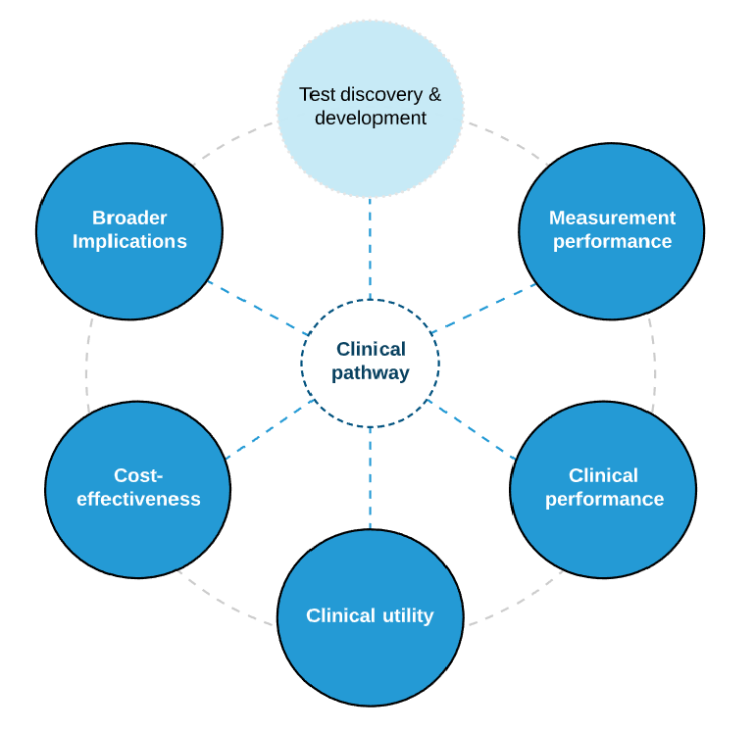
Test Evaluation Pathway
AKA ‘analytical validity’ or ‘technical performance’
Legal & ethical concerns
Societal impact
Equity impact
The ability of a test to provide a true and precise measurement of the measurand (i.e. substance of interest) in the test sample
Central component = measurement uncertainty
ICER = ∆C/ ∆E
INMB = ∆E*k - ∆C
Diagnostic accuracy: sensitivity & specificity, PPV & NPV
Prognostic utility (LR, OR)
Patient & clinical decision making
Health outcomes (morbidity, mortality, quality of life)

Slide 4
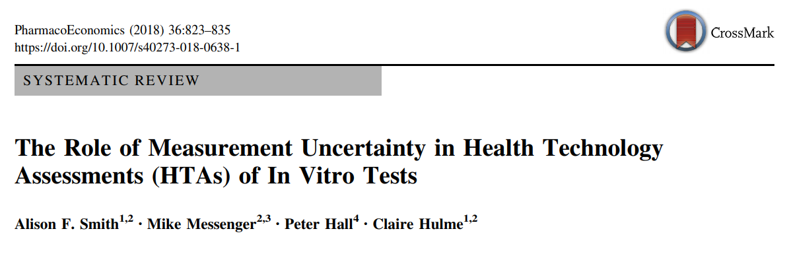
HTA landscape
  N=20/107 (19%) HTAs assessed some aspect of measurement performance
  N=15 “pre-model” assessments (incl. literature review, lab survey, lab data)
  N=5 included data within the economic model
  N=1 modelled the impact of increasing error
MSAC and CADTH are the only HTA bodies currently to mention measurement performance – but with little/no guidance as to methods of assessment

Slide 5
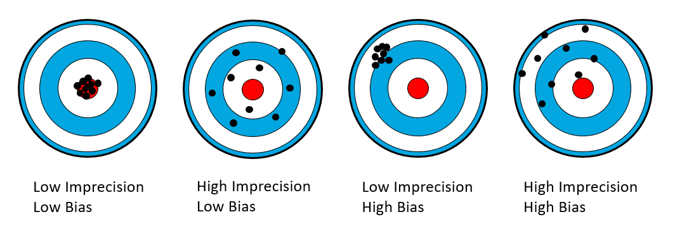
Measurement uncertainty
Two key components:
Precision: closeness of agreement between repeated tests [random error/ imprecision]
Trueness: closeness of agreement between observed test and ‘true’ value [systematic error/ bias]

Slide 6
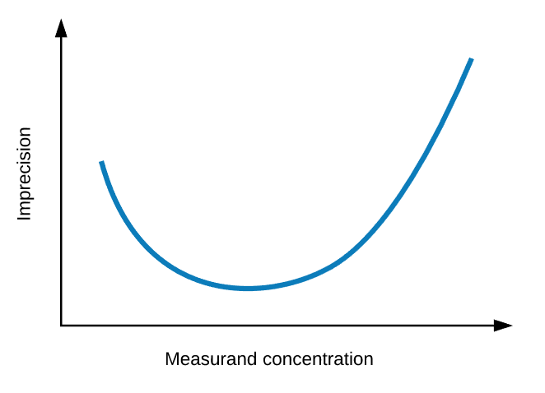
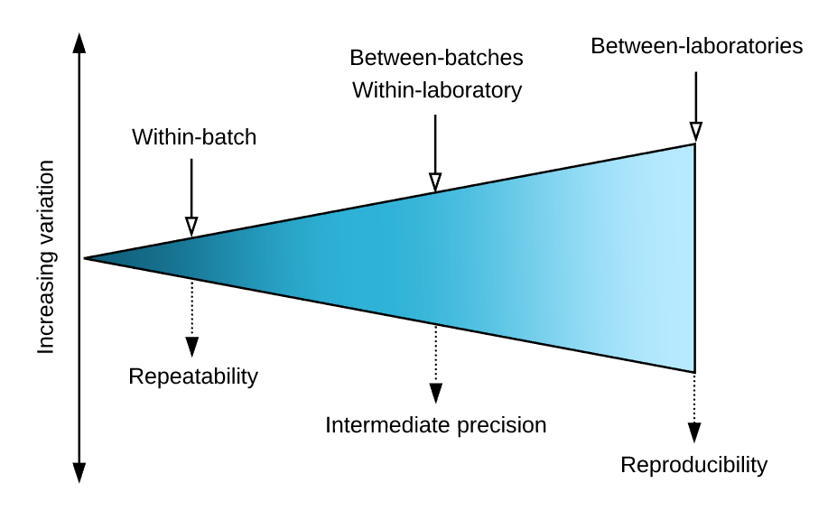

Measurement uncertainty
Precision
Expressed as an SD or coefficient of variation (CV % = $\frac{SD ∗ 100}{\overline{x}}$ )
Depends on number of key factors: time, operator, calibration, environment and equipment)
3 levels: Repeatability, Intermediate precision, Reproducibility
Notes:
CV = the ratio of the SD to the mean, multiplied by 100.
Use CV as precision is often dependent on the measurand concentration. This is illustrated by the characteristic U-shaped curve tests typically display in their precision profile. The precision profile shows the precision of a test over the complete range of measurand values expected in practice.
Typically a U-shaped curve: higher imprecision at low and high concentrations.

Slide 7
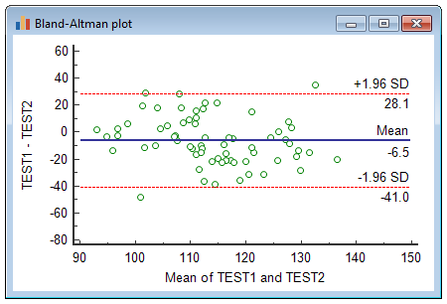
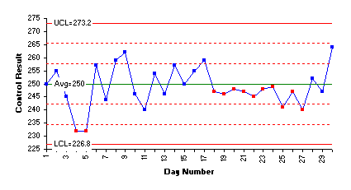
Measurement uncertainty
Bias
Difference between index test vs. reference test (proxy for ‘true’ value)
Ideally based on a reference measurement procedure or certified reference materials
Assessed via Bland-Altman analysis / regression/ Levey Jennings plot
Notes:
Plot of fixed, proportional, and non-linear bias – TO DO
Bland altman plot – can identify outliers, assess if bias is proportional or fixed.
Levy Jennings – assessed using Westgard rules.
Levey Jennings- have a control value that is known. Run using test over time.
Westgard rules:
1_{2s}: This test sends a signal if there is a point beyond +/- 2 standard deviations.
1_{3s}: This test sends a signal when a point exceeds +/- three standard deviations.
2_{2s}: This test sends a signal if two consecutive points are beyond + 2 standard deviations from the mean or beyond -2 standard deviations from the mean.
R_{4s}: This test sends a signal when one point is beyond +2 standard deviations and the following point is beyond -2 standard deviations or vice-versa.
4_{1s}: This test sends a signal when 4 consecutive points exceed +1 standard deviation or 4 consecutive points exceed -1 standard deviation.
10_{x}: This test sends a signal when 10 consecutive control measurements fall on one side of the centerline. Other common values used include 8 and 12

Slide 8
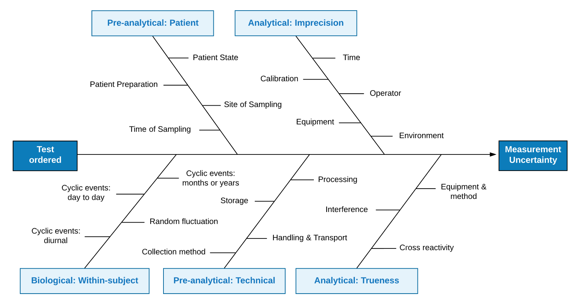
Measurement uncertainty
How much do we expect the test result might differ from the underlying ‘true’ value?
Notes:
Lots of things can have an impact – mainly by altering the concentration of substances in the test sample, or by affecting the ability of a test to correctly identify what’s in the sample.
Before you’ve even got to the laboratory there’s lots of things that can affect a tests measurement performance which are labelled pre-analytical factors, as well as biological variation in patients.
In the lab we have the analytical phase, which concerns all processes involved at the point of test sample analysis. Factors affecting the measurement performance here include things like the process of test calibration, the time of day, the equipment.. There also may be issues to do with other substances in the test sample which might interfere with the measurement process.
All of these factors can contribute to uncertainty in the test measurement. We can think about the value of measurement uncertainty as telling us how much we might expect the test result to differ from the underlying ‘true’ value.

Slide 9
Measurement uncertainty
Why should health economists care about measurement uncertainty?
All observed results will differ from the ‘true’ value we want to measure (i.e. they will be wrong, to some degree)
Any measure of diagnostic accuracy will incorporate a specific level of measurement uncertainty relating to the particular conditions under which the accuracy study was conducted (i.e. the test may perform differently when rolled out across the health service)
Why should laboratory scientists care about HTA outcomes?
If the goal is to maximise patient health, and tests impact on patient healthcare, then the minimum allowable performance of tests should be set based on the impact on outcomes
  Move towards “Performance Specifications based on Outcome Studies” (PS-OS) [see https://www.eflm.eu/site/page/a/1396]
Notes:
COULD EXPAND HERE

Slide 10
Laboratory landscape
  MILAN Criteria for Analytical Performance Specifications (APS)
  Model 1: Based on the effect of analytical performance on clinical outcomes
    A: direct studies
    B: indirect studies
  Model 2: Based on components of biological variation of the measurand
  Model 3: Based on state-of-the-art
“Model 1, based on the effect of APS on clinical outcome, is the model of choice for measurands that have a central role in the decision-making of a specific disease or clinical situation and where cut-off/ decision limits are established for either diagnosing, screening or monitoring”
Sandberg et al. Clin Chem Lab Med 2015; 53(6): 833–835.
Ceriotti et al. Clin Chem Lab Med 2017; 55(2): 189–194
Notes:
NOTE SOMETHING AOUT REGULATION AND

Slide 11
Laboratory landscape
“If outcome-based studies do not exist, researchers should be encouraged to perform them, either direct studies based on double-blind RCTs or indirect outcome studies based on the impact of analytical performance of the test on clinical classifications or medical decision and thereby on probability of outcomes (e.g. by simulation or decision analysis)”
Ceriotti et al. Clin Chem Lab Med 2017; 55(2): 189–194

Slide 12
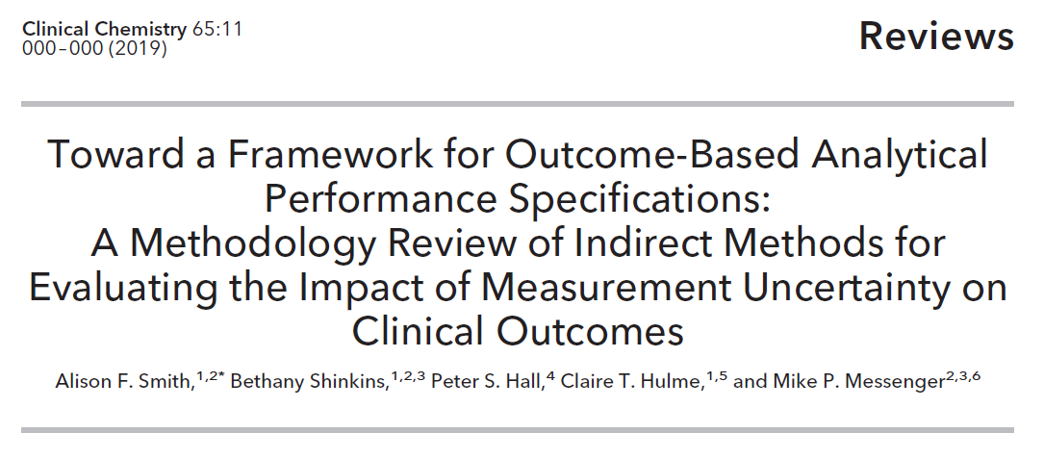
Methodology review
Indirect studies incorporating/ exploring the impact of measurement uncertainty on HTA outcomes (clinical performance, utility, costs, cost-effectiveness)
In-vitro test or medical device
Database searches (covering 10-year period + update) + citation tracking (any date)
82 studies identified

Slide 13
Methodology review
Step 1:
Calculation of “true” test values
Step 2:
Calculation of measured test values
(incorporating MU)
Step 3:
Calculation of the impact of measurement discrepancies on outcomes
Empirical data
Parametric data
Error model simulation
Diagnostic accuracy assessment
Decision modelling
Test_{sim} = Test_{true} + [Test_{true} x N(0,1) x CV] + Bias

Slide 14
Case study – faecal calprotectin
Calprotectin: a marker of inflammation in the gut
Faecal Calprotectin (FC): currently recommended in the UK to help distinguish between Inflammatory Bowel Disease (IBD) and Irritable Bowel Syndrome (IBS) [NICE DG11]
BUT.. Some concerns over the reproducibility and accuracy of this test
  Between-lab imprecision (CV%) ≤ 60%
  Between-method bias ≤ +/- 250 micrograms/gram (ug/g)

Slide 15
Case study – faecal calprotectin
NICE FC pathway:
Single-test strategy using the “standard” 50 ug/g faeces cut-off threshold
York FC Primary Care Pathway (YFCCP):
Raised cut-off threshold (100 ug/g)
Following an initial FC test (FC1), patients with an elevated result receive a second test (FC2) to confirm elevation before referral
Both pathways evaluated using the YFCCP database (n=951)
Notes:
Two complicating Issues in this case study – limits of quantification and repeat testing

Slide 16
Case study – faecal calprotectin
  Single-test error model approach (applied for NICE FC pathway evaluation):
  Sample 10,000 baseline FC1 values (FC1_{true}) for IBD and IBS patients (IBD incidence ~8%) [bootstrap sampling or parametric sampling]*
  For each FC1_{true} value, simulate a value including additional measurement uncertainty (FC1_{sim}) according to the error model:
  Based on the 10,000 FC1_{sim} values, compute summary statistics for the diagnostic accuracy of FC (i.e. sensitivity, specificity) [nb: this is possible because we know each individual’s final clinical diagnosis]
  Repeat steps 2-3 for a range of bias (e.g. -100 to 100 in 1 unit increments) & imprecision (0-100% in 1% increments) values
  Similar approach for YFCCP, but apply error model twice – first to FC1 data, and second to FC2 data.
  *all results shown in following slides are for bootstrap method (which had higher internal validity)
FC1_{sim} = FC1_{true} + [FC1_{true} x N(0,1) x CV] + Bias

Slide 17
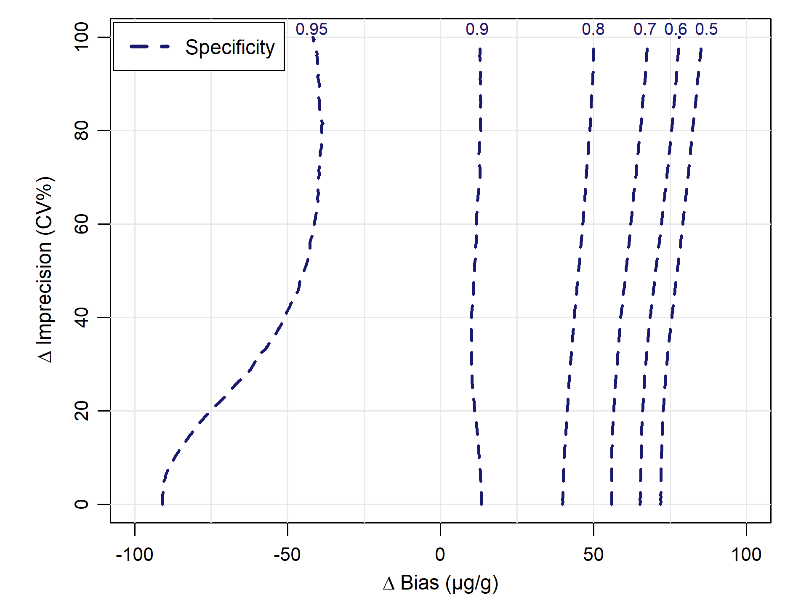
Case study - results
Specificity (TN/ TN+FP)
Decreases with positive bias since this pushes IBS patients above the threshold (more FPs)
Improves with negative bias since this pulls IBS patients below the threshold (less FPs)
Unaffected by imprecision: increasing spread of IBS FC1 distribution does not sign. alter the proportion falling above 100 μg/g
YFCCP

Slide 18
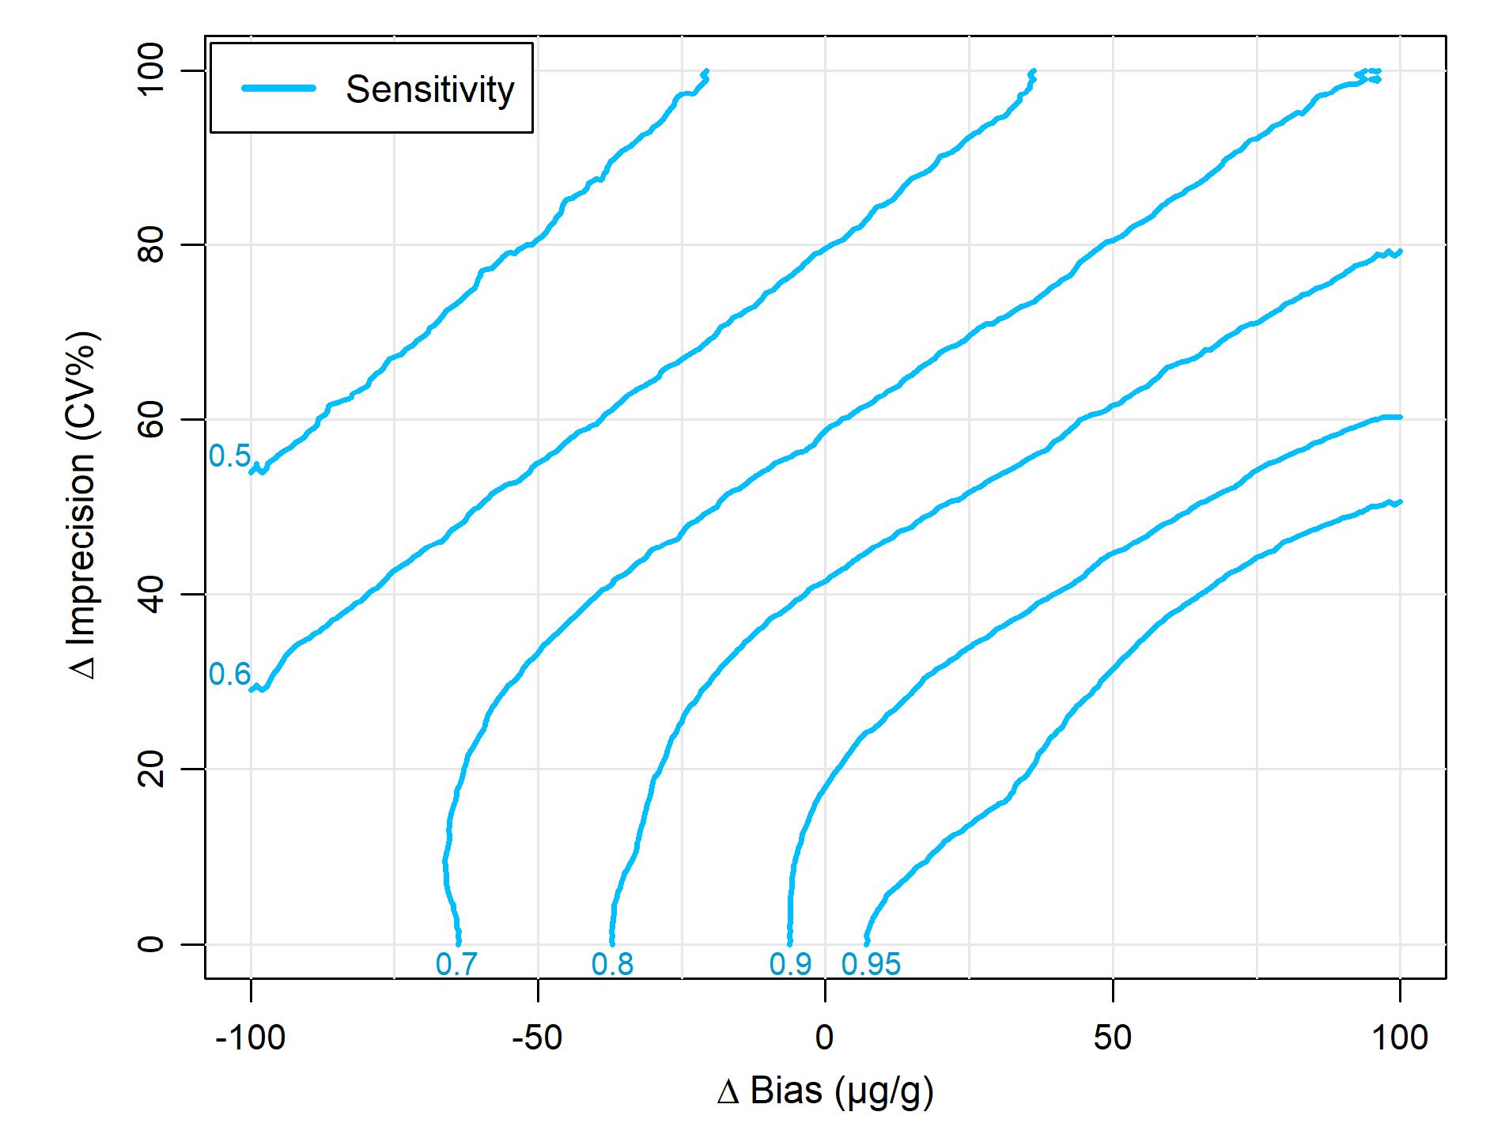
Case study - results
Sensitivity (TP/ TP+FN)
Improves with positive bias since this pushes IBD patients above the threshold (more TPs)
Decreases with negative bias since this pulls all IBD patients below the threshold (more FNs)
Decreases with imprecision: increasing spread of IBD FC1 distribution increases the proportion falling below 100 μg/g
YFCCP

Slide 19
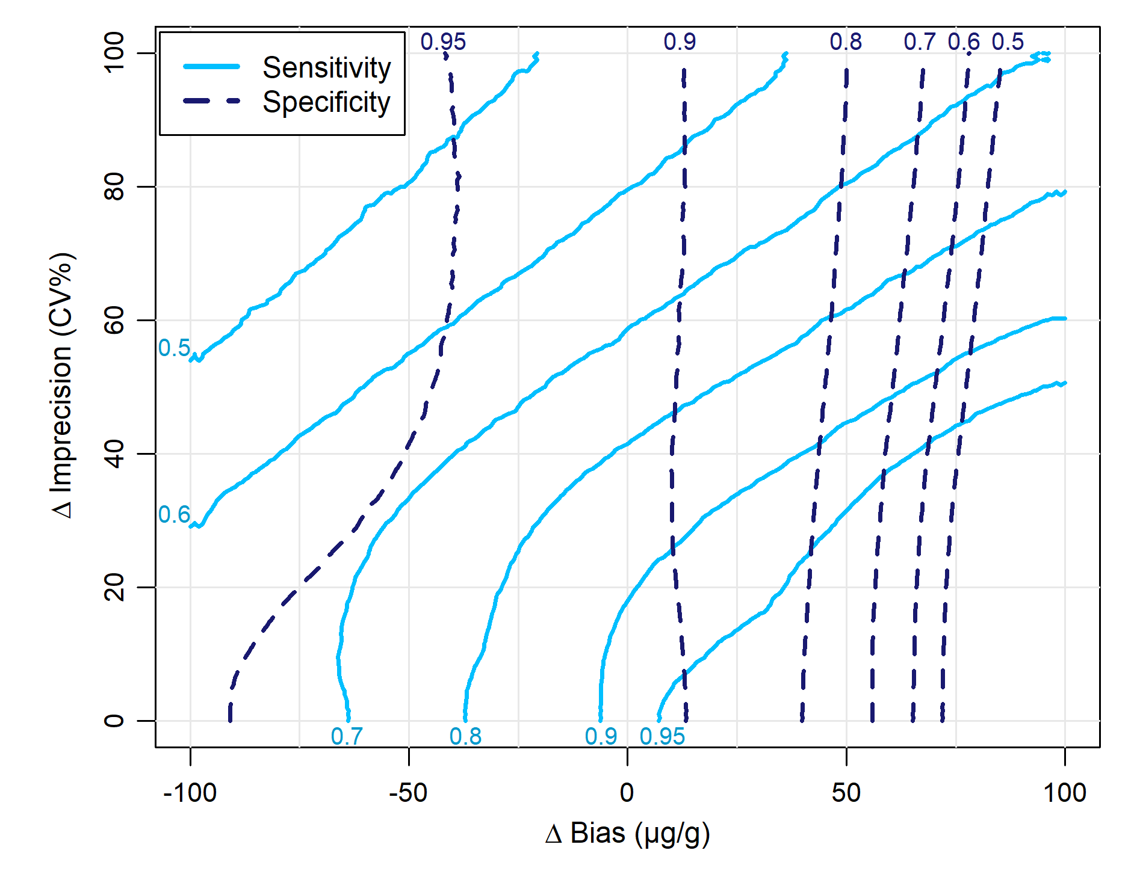
Case study - results
Using the contour plots we can identify different “acceptable regions” of bias & CV based on
assumed minimum requirements for diagnostic sensitivity and specificity values e.g. lower CI values from empirical data
YFCCP

Slide 20
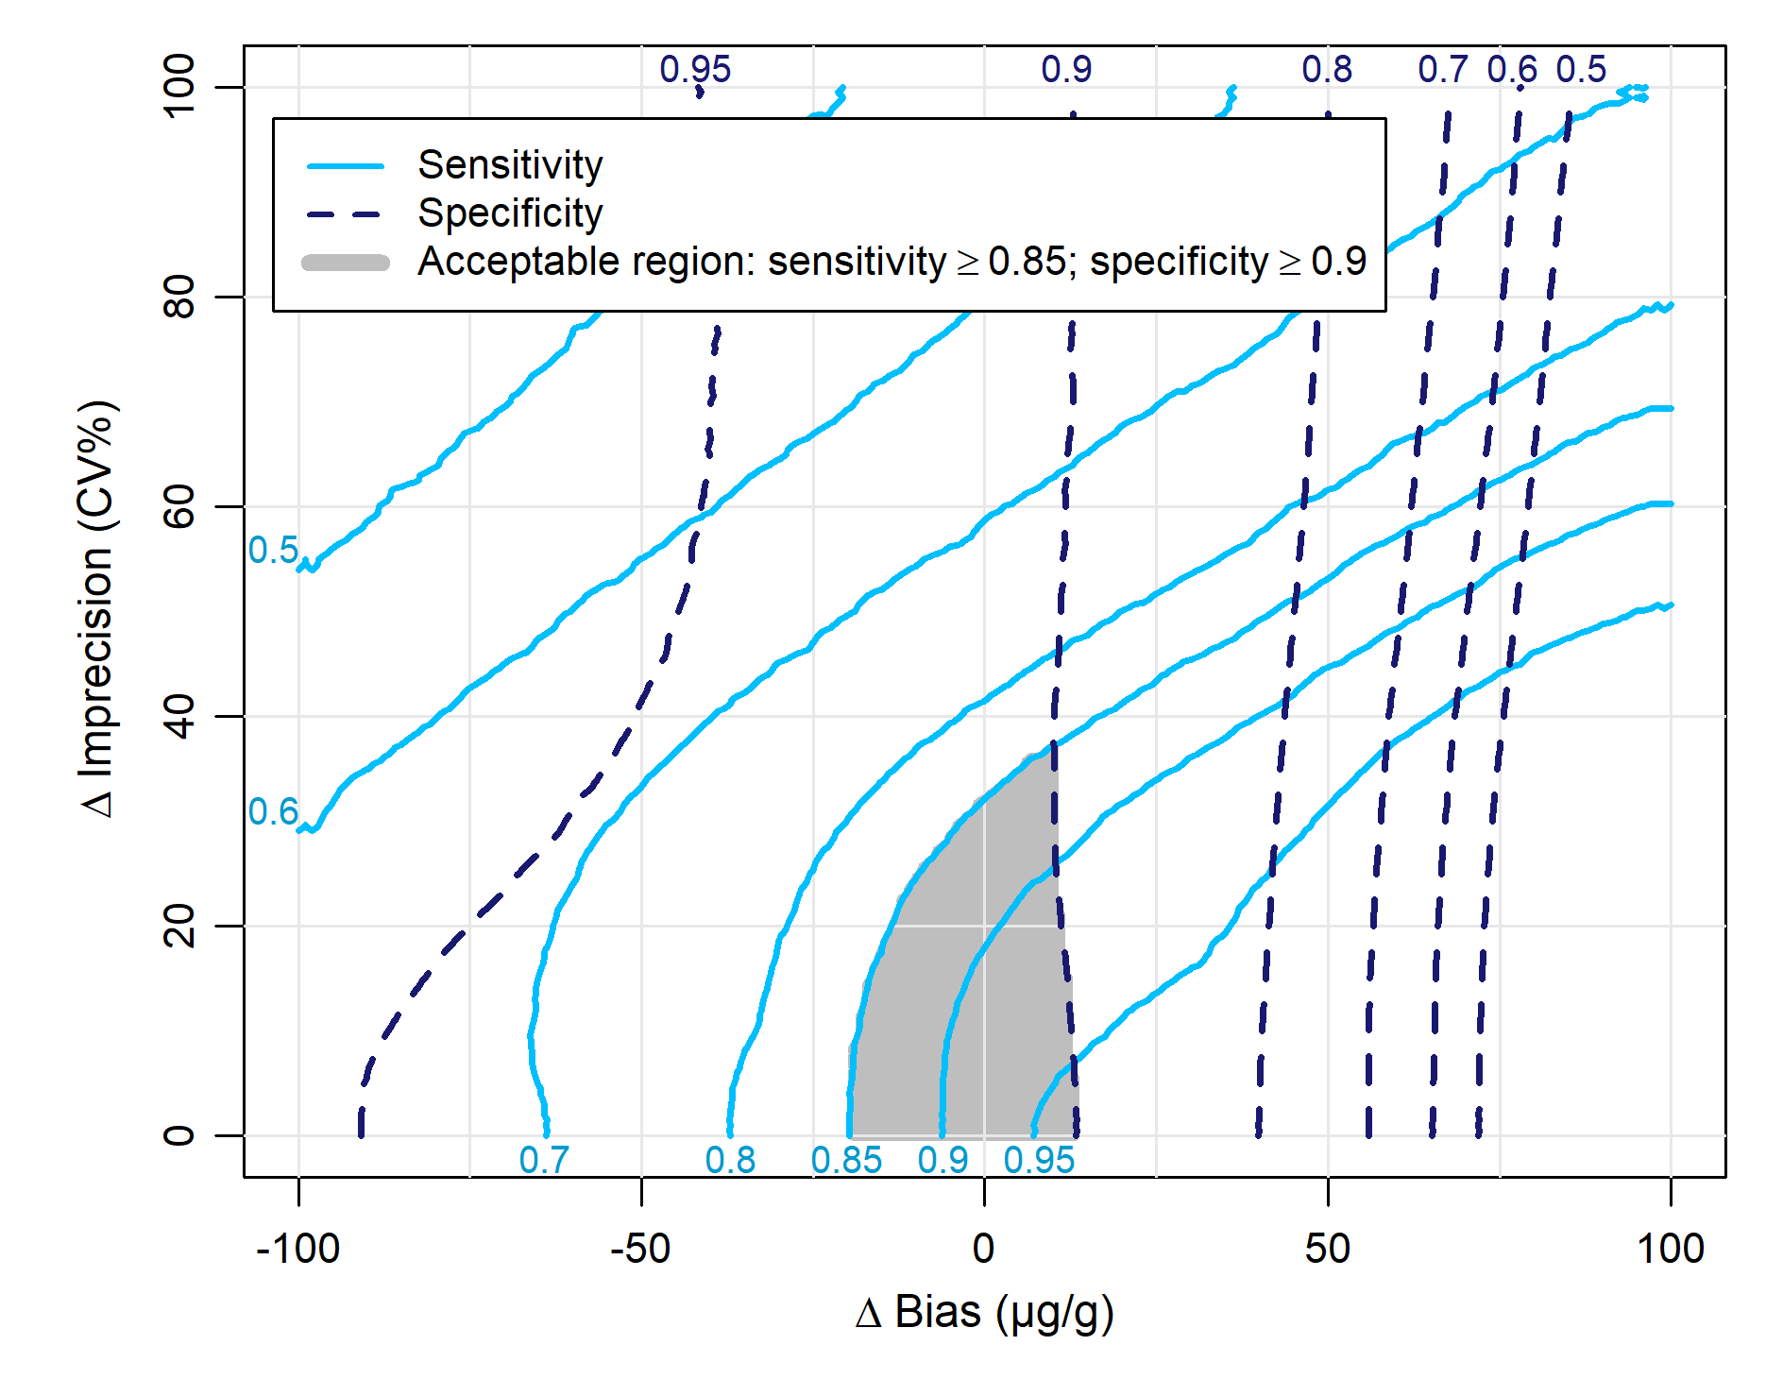
Case study - results
Using the contour plots we can identify different “acceptable regions” of bias & CV based on
assumed minimum requirements for diagnostic sensitivity and specificity values e.g. lower CI values from empirical data
YFCCP

Slide 21
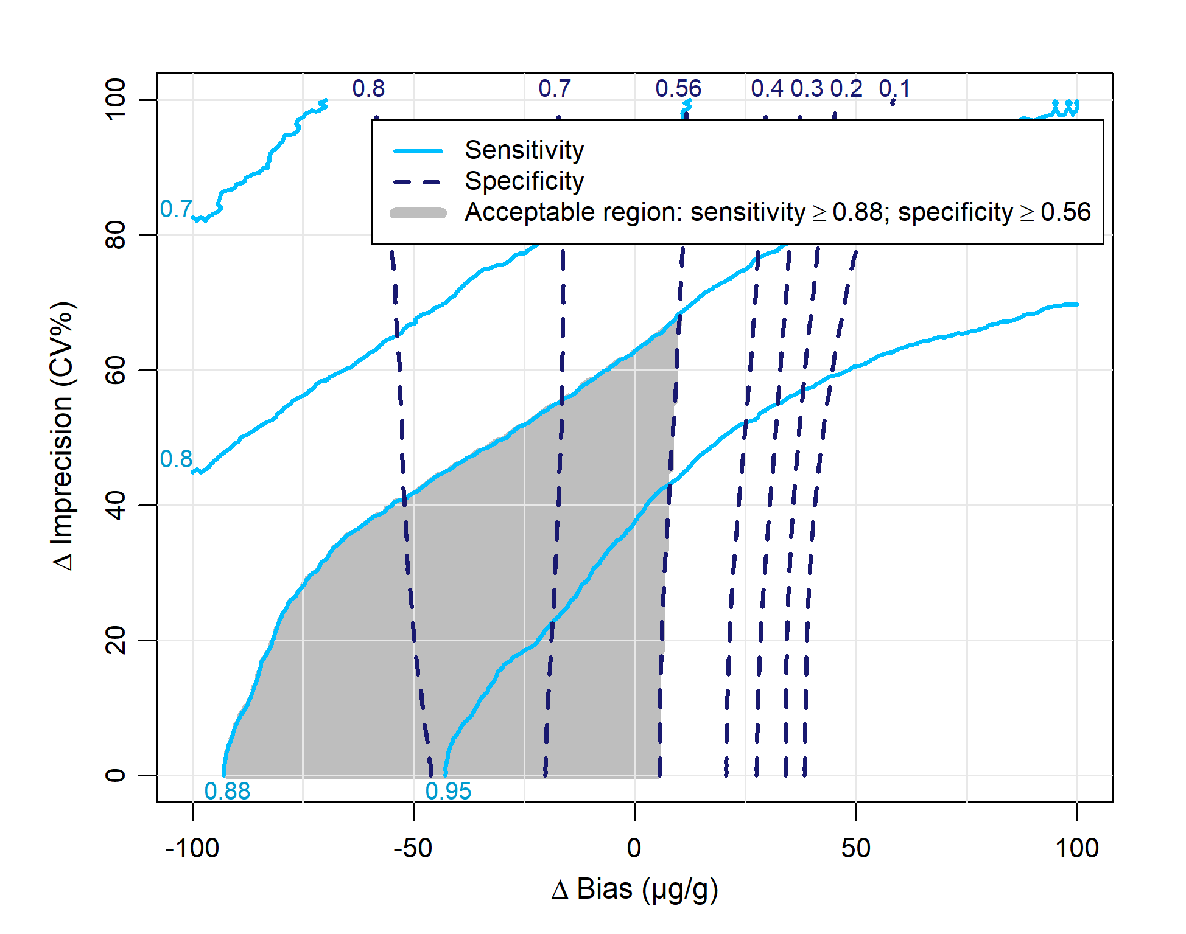
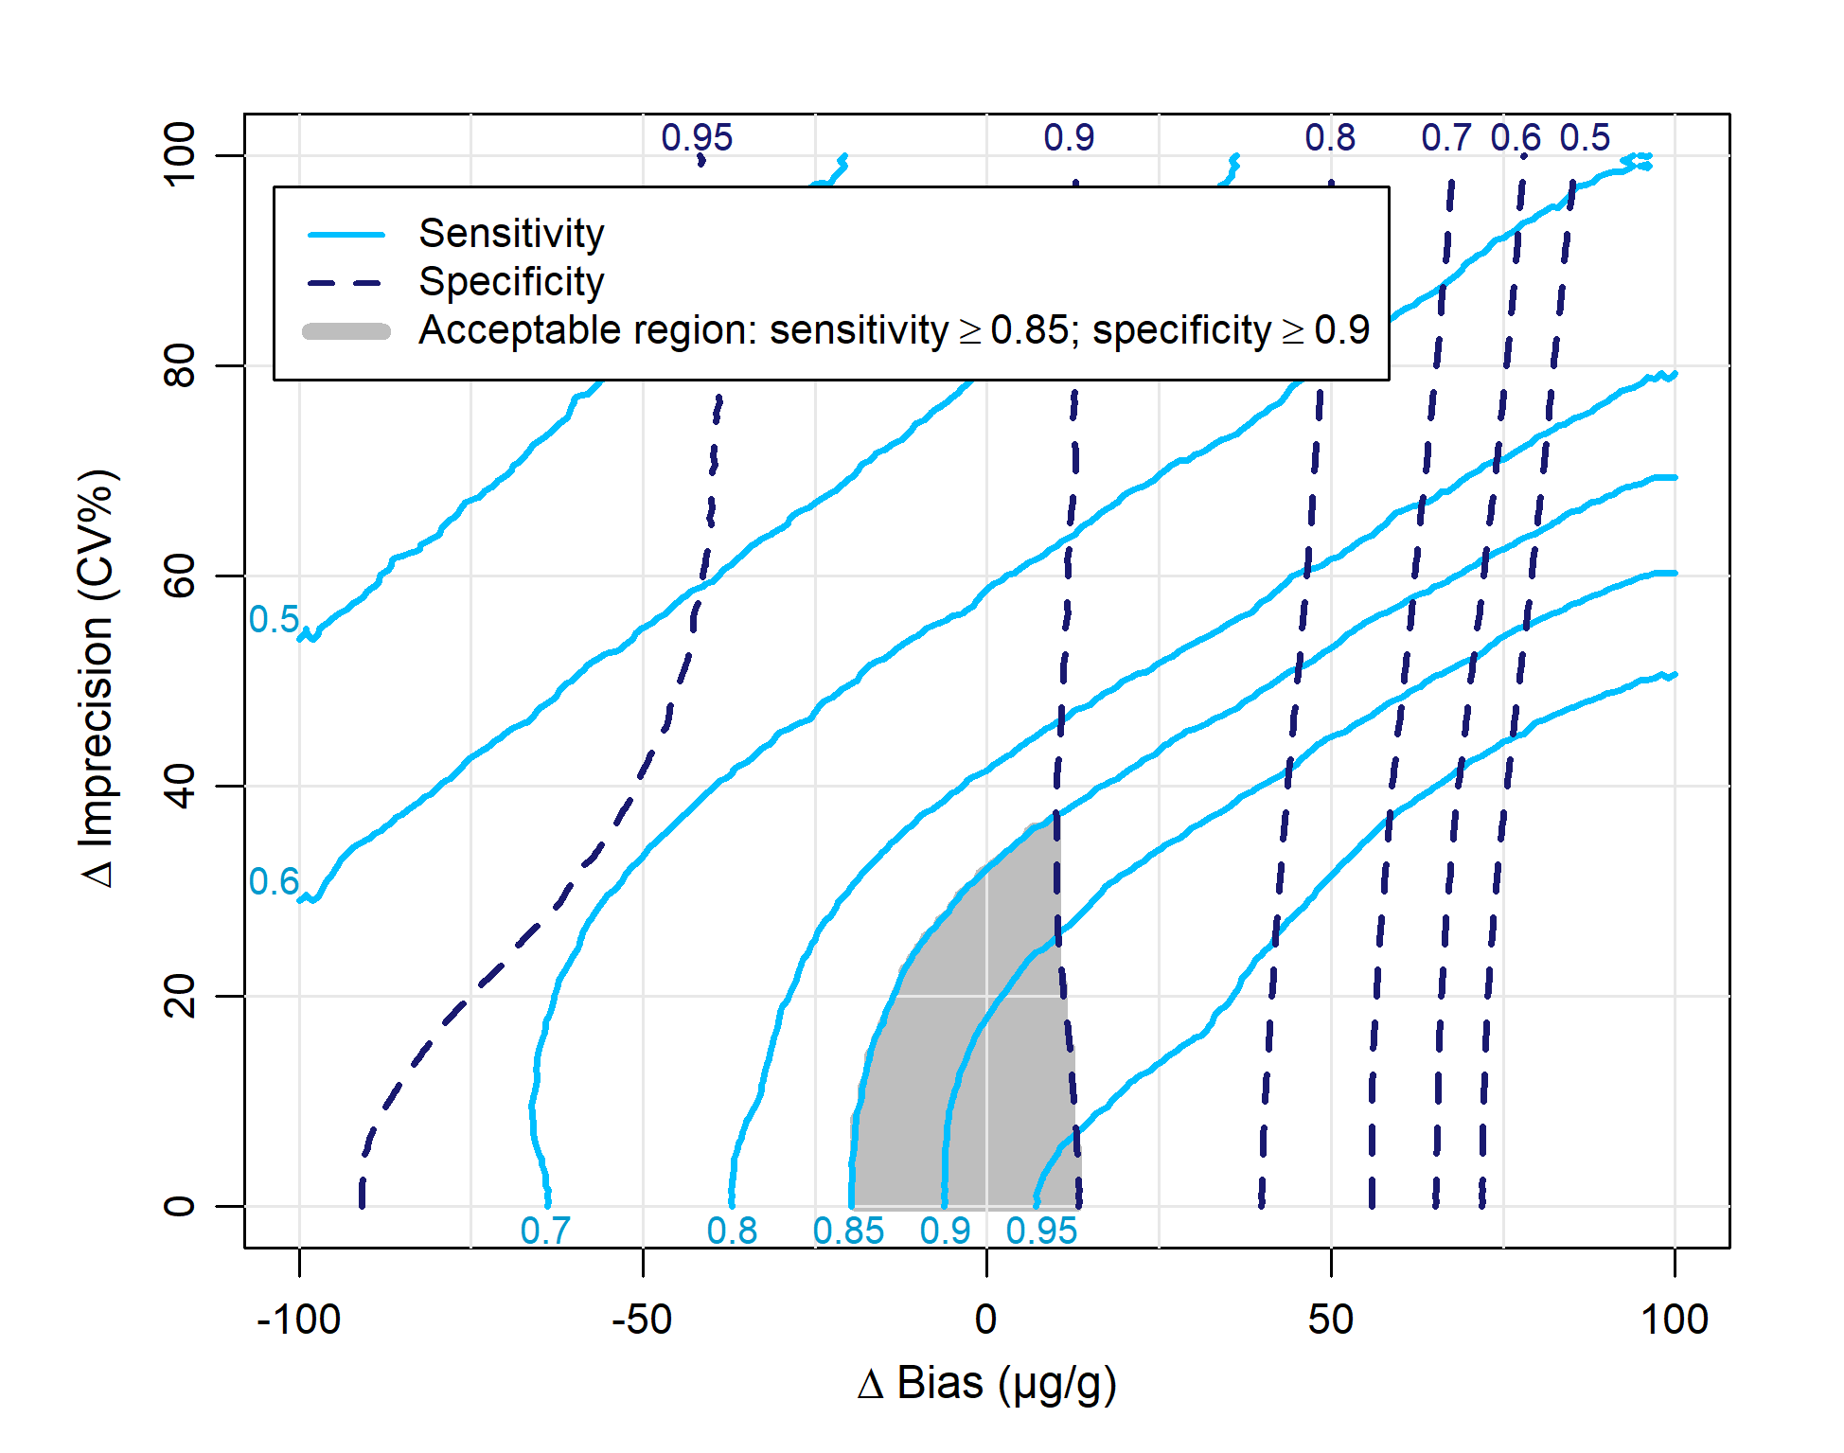
Case study - results
NICE FC Pathway
YFCCP
Note: not comparing like-for-like here. Acceptable region for each pathway has been set at the lower 95% CI for diagnostic accuracy based on the empirical data analysis.
For the NICE FC pathway, better performance is achieved by applying negative bias – equivalent to raising the threshold (i.e. this pathway is not optimised). For the YFCCP, diagnostic accuracy is optimised around the (0,0) point
Notes:
YFCCP vs. NICE FC pathway:
Same overall “shape” of contour plots
YFCCP associated with higher baseline specificity, lower sensitivity
YFCCP specificity more robust to bias
YFCCP sensitivity less robust bias & CV

Slide 22
Case study
    Extending the analysis to cost-effectiveness outputs
    Using a previously conducted cost-effectiveness model:
      Iteratively adjust sensitivity and specificity estimates within the model
        each sensitivity & specificity value linked to a given imprecision and bias value
        each iteration provides cost, Quality-adjusted life year (QALY) and incremental net benefit (INB) outputs
Produces a “two-step” linked-evidence model:
Measurement >> diagnostic accuracy>> cost-effectiveness

Slide 23
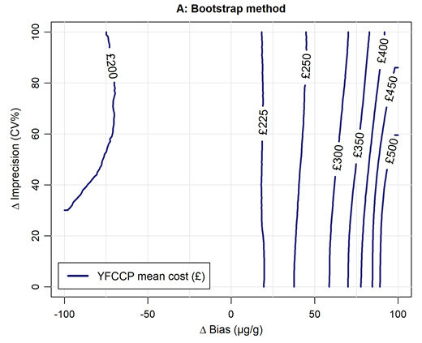
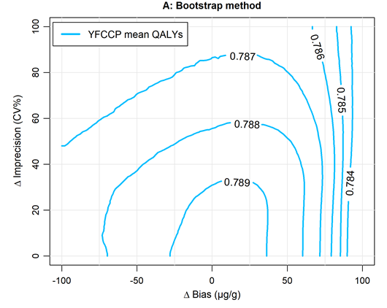
Case study

Slide 24
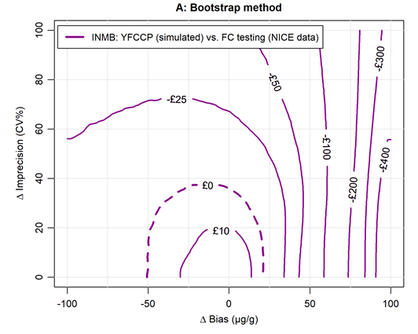
Case study

Slide 25
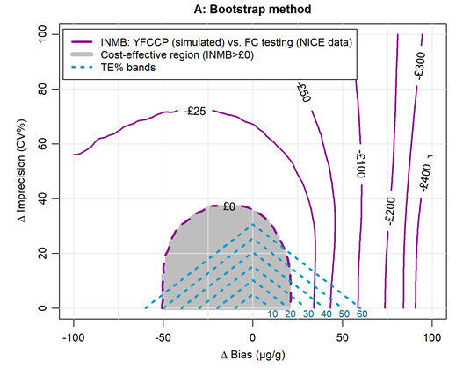
Case study

Slide 26
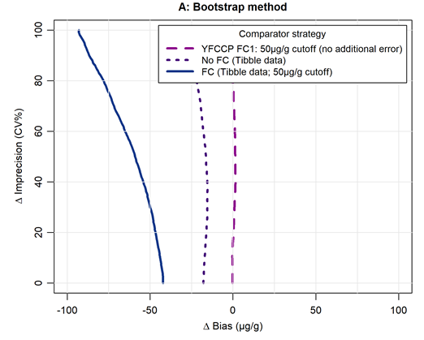
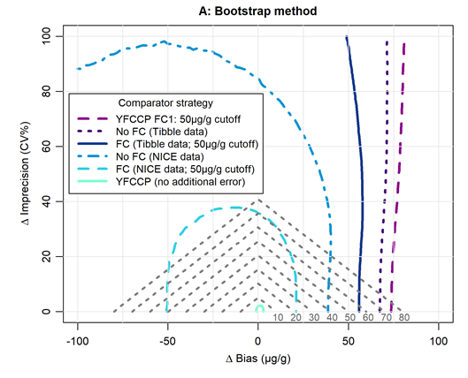
Case study
Comparison of the position of the zero INMB line for the two FC pathways illustrates that the NICE FC pathway is largely dominated, whilst the YFCCP achieves a reasonable cost-effective region compared to most comparators
NICE FC Pathway
YFCCP

Slide 27
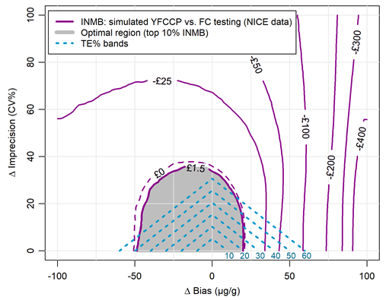
Case study
An alternative approach is to select the “optimal region” – set as the top x% of INMB (or NMB) results (where x is user-defined)
This may be a useful approach when the cost-effective region is unacceptably large (e.g. when comparing against poor-performing comparators)
Can be used to quantify the added/lost benefit of imposing tighter/looser APS

Slide 28
Limitations
      Baseline error: limits interpretation of results (methods are available to “strip” known baseline error from simple parametric distributions, but this requires reliable data on baseline error & method for more complex distributions not yet documented)
      External validity: results sensitive to data distributions – if these are expected to change by region then the findings may not hold
      Missing FC2 data for YFCCP: unclear if this may bias the results. Sensitivity analysis simulating FC2 value by drawing from distribution of differences suggests that the base case APS regions are conservative
      Economic model: short time horizon & deterministic

Slide 29
Key advantages
    HTA perspective:
      Explore possible impact of increased measurement uncertainty following wide-scale adoption
      Inform the need & design of post-adoption surveillance strategies
      Laboratory perspective:
      Inform outcome-based analytical performance specifications (APS)
      Inform the need for & design of EQA/ proficiency testing schemes

Slide 30
Recommendations for HTA
All HTAs should include a formal assessment of measurement uncertainty
Ideally including both pre-model and model-based assessment [first to quantify uncertainty and identify key issues; second to assess the impact of this uncertainty & identify outcome-based APS]
Error model simulation and the two-step linked-evidence approach offers an efficient and flexible method for model-based analyses
Greater collaboration with laboratory/test specialists is needed
Assessment of measurement uncertainty should be prioritised when false diagnoses have serious consequences/ APS needed/ multiple assays evaluated
Future research areas: guidance on lit-review methods; assessment of MU within clinical studies; application of modelling methods to other test scenarios; issue of baseline MU; communication of APS to laboratory community; possible trial-based approaches

Slide 31
Your thoughts
What would you need to convince you to do this kind of analysis?
What do you see as being the key barriers to conducting pre-model and/or model based analyses?
Any specific tools/ guidance which you think could help?
How much interaction with test specialists do you (HTA/ reviewers/ economists) currently have? How do you think this could be improved (if needed)?

Slide 32
Acknowledgements
  Funding: NIHR Doctoral Research Fellowship
  Supervisory team: Bethany Shinkins (Leeds), Mike Messenger (Leeds), Peter Hall (Edinburgh) & Claire Hulme (Exeter)
  Additional thanks to:
    The project’s scientific advisory board team
    EFLM Test Evaluation Group members
    YFCCP patients
    YHEC (Hayden Holmes)
  Alison Smith: a.f.c.smith@leeds.ac.uk

Slide 33
References
HTA systematic review:
  Smith AF, Messenger MP, Hall PS, Hulme CT. The Role of Measurement Uncertainty in Health Technology Assessments (HTAs) of In Vitro Tests. PharmacoEconomics 2018;36:823-35
Methodology review:
  Smith AF, Shinkins B, Hall PS, Hulme CT, Messenger MP. Towards a Framework for Outcome-Based Analytical Performance Specifications: a Methodology Review of Indirect Methods for Evaluating the Impact of Measurement Uncertainty on Clinical Outcomes. Clinical Chemistry 2019:clinchem.2018.300954
EFLM guidance on analytical performance specifications:
  Sandberg S, Fraser CG, Horvath AR, Jansen R, Jones G, Oosterhuis W, et al. Defining analytical performance specifications: consensus statement from the 1st Strategic Conference of the European Federation of Clinical Chemistry and Laboratory Medicine. Clin Chem Lab Med. 2015;53(6):833-5
  Ceriotti F, Fernandez-Calle P, Klee GG, Nordin G, Sandberg S, Streichert T, et al. Criteria for assigning laboratory measurands to models for analytical performance specifications defined in the 1st EFLM Strategic Conference. Clin Chem Lab Med. 2017;55(2):189-94

