Slide 1
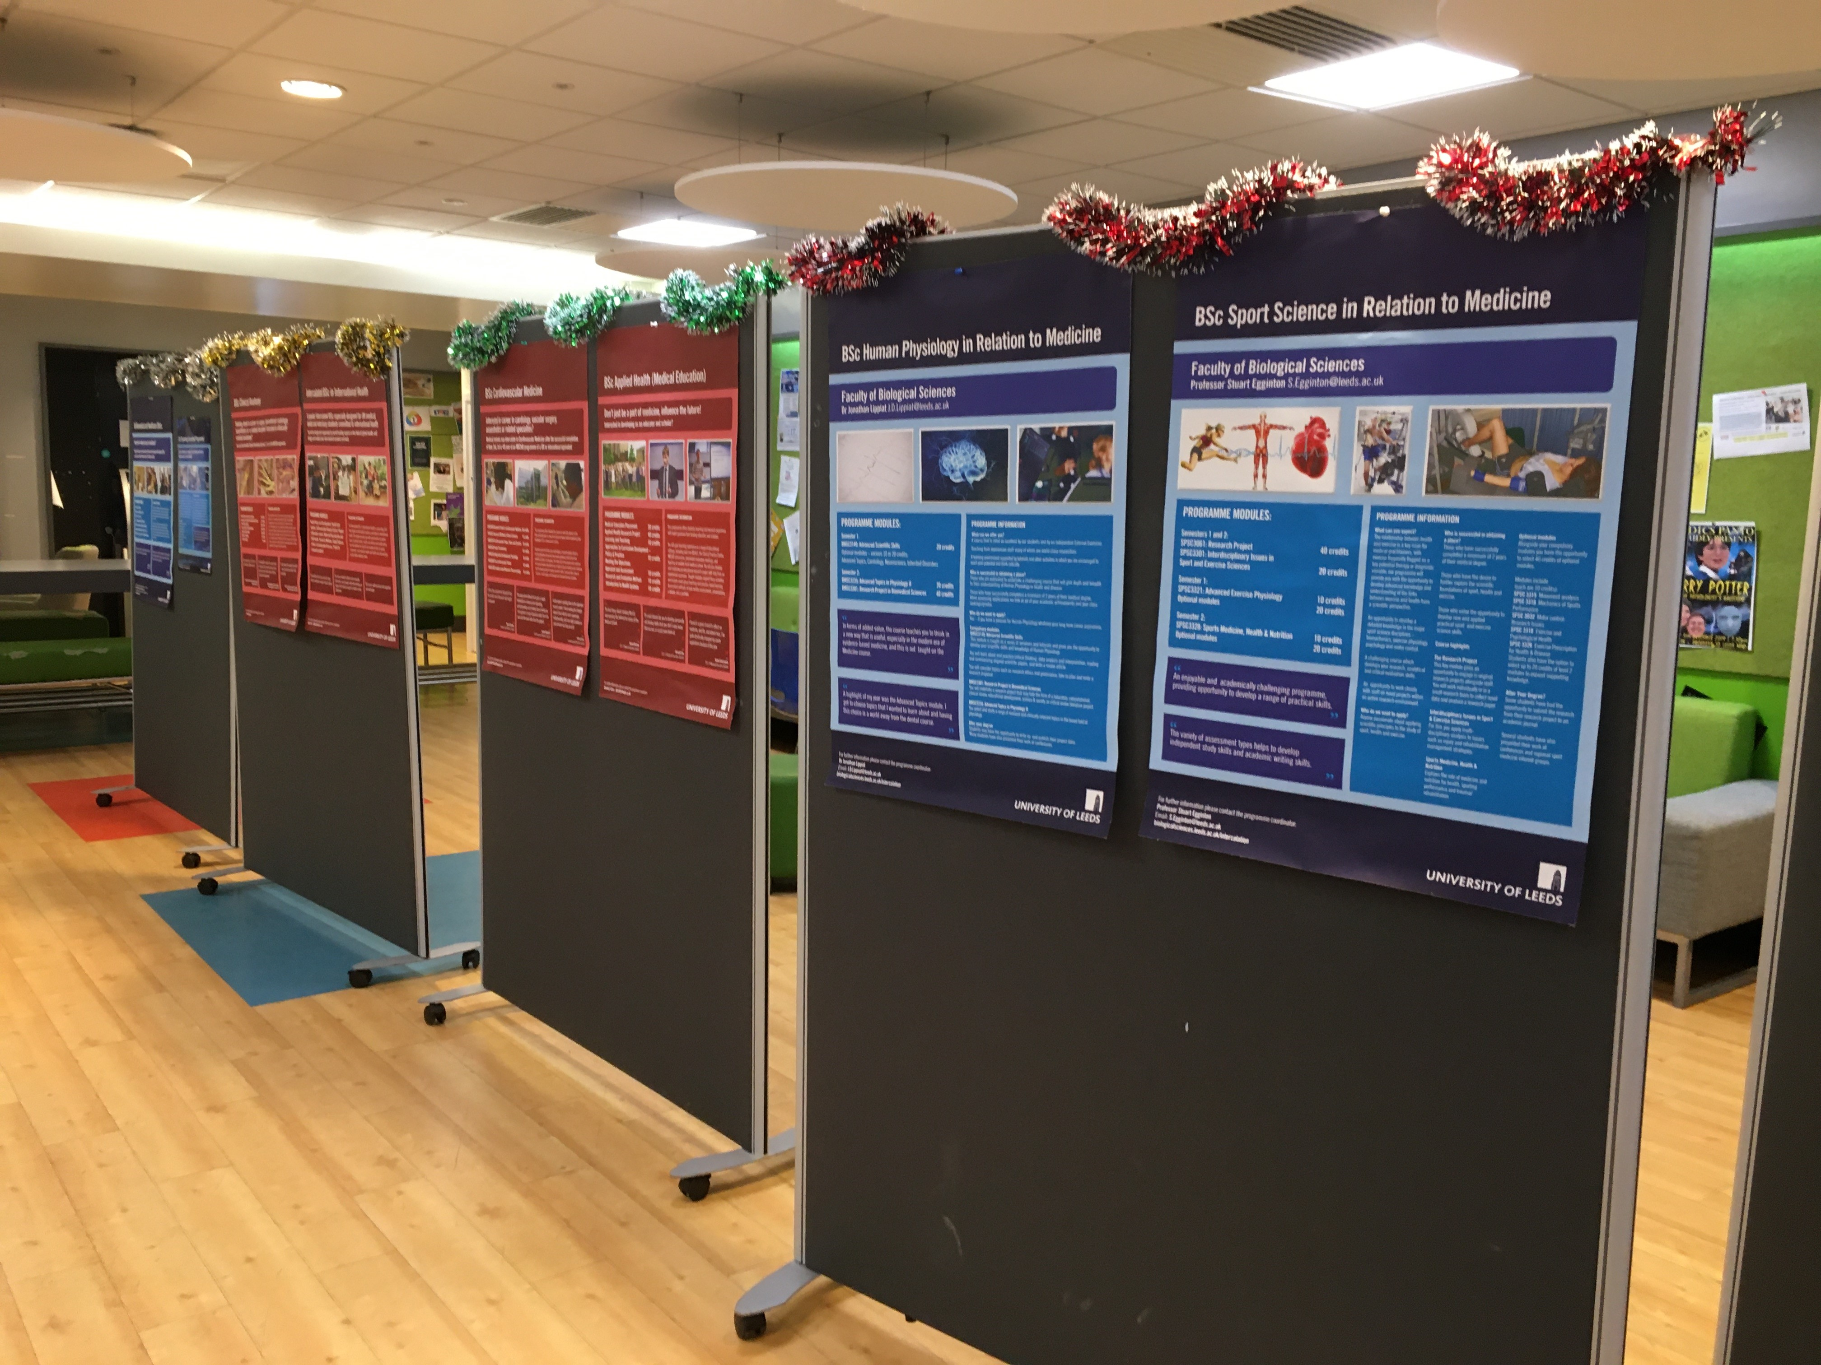
Adding your title
Intercalation at the University of Leeds
Dr Alison Ledger
Head of Intercalated Programmes
A.Ledger@leeds.ac.uk

Slide 2
Representing a school and/or faculty
Benefits of Intercalation
Broadening knowledge of important aspects of medicine which are outside of the core medical curriculum
Developing your research skills
Gaining a competitive edge in applying for clinical posts

Slide 3
1. Broadening knowledge
Leeds Intercalated Portfolio
Undergraduate programmes in the School of Medicine
Undergraduate programmes in other parts of the University
Masters level programmes
(inside or outside of Medical School)

Slide 4
Undergraduate programmes in the School of Medicine (BSc)
Applied Health (Medical Education)
Cardiovascular Medicine
Clinical Anatomy
International Health

Slide 5
Undergraduate programmes in other parts of the university (BA/BSc)
Biomedical and health care ethics
Human physiology in relation to medicine
Microbiology in relation to medicine
Cell biology of human disease
Neuroscience in relation to medicine
Pharmacology in relation to medicine
Psychology
Sports Science in relation to medicine
Zoology in relation to medicine and veterinary science

Slide 6
Masters degrees
MA Biomedical and Healthcare Ethics
MSc Cancer Biology and Therapy
MSc Medical Imaging
MA History of Health Medicine and Society
MSc Enterprise and Entrepreneurship
MSc Molecular Medicine
MRes Medicine
MSc Precision Medicine: Genomics & Analytics

Slide 7
2. Developing research skills
Intercalation:
provides a rigorous training in critical analysis of scientific papers, conducting research projects, practical laboratory skills etc.
The introduction to research module was exceptional. The concepts were presented in an easy to follow and understand way. This was underpinned by practice coursework and formative assessments that helped put into practice the concepts before applying them in summative assessment.
…you are encouraged to work and think independently in developing your research project but receive excellent support, teaching and knowledge from staff on the course guiding you through your work
(Responses from 2018-19 Intercalated Programmes Survey)

Slide 8
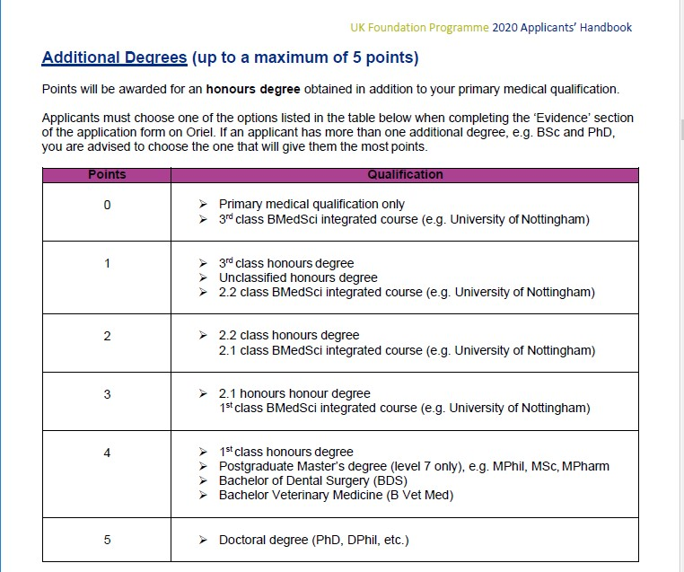
3. Gaining a competitive edge
Foundation Programme Application (FPAS) Points
+ 2 points for publications

Slide 9
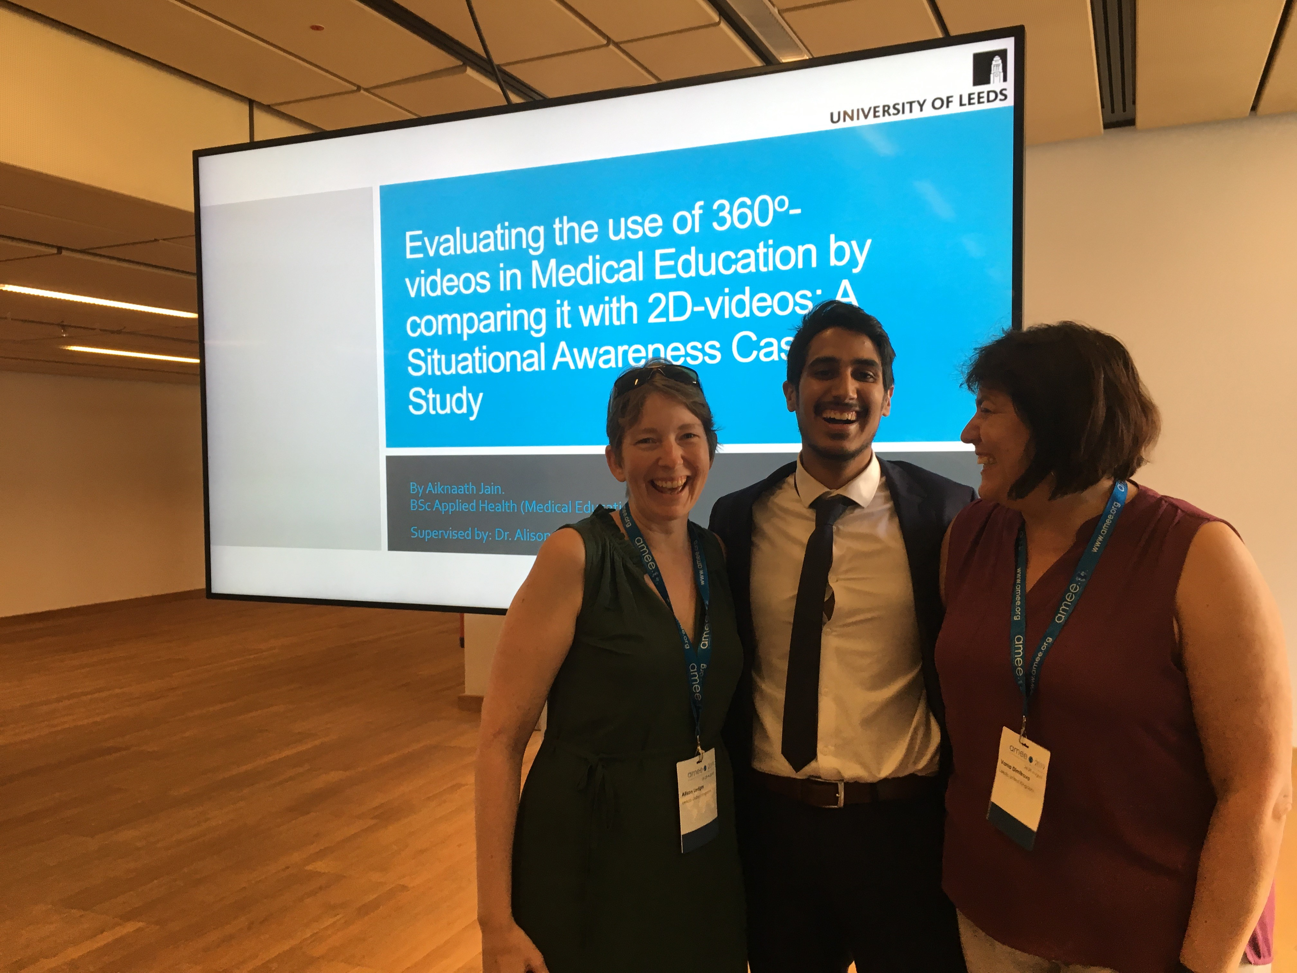
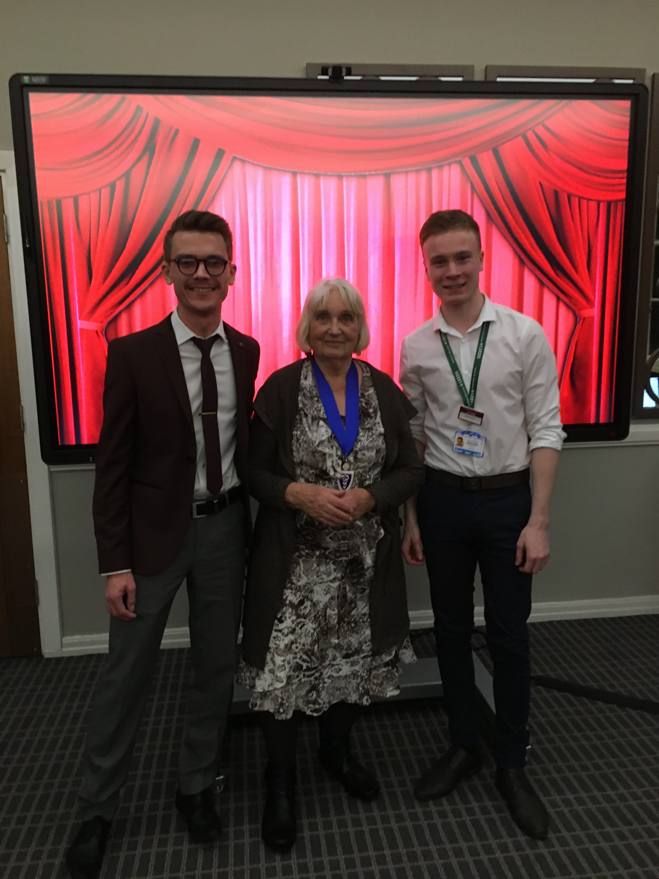
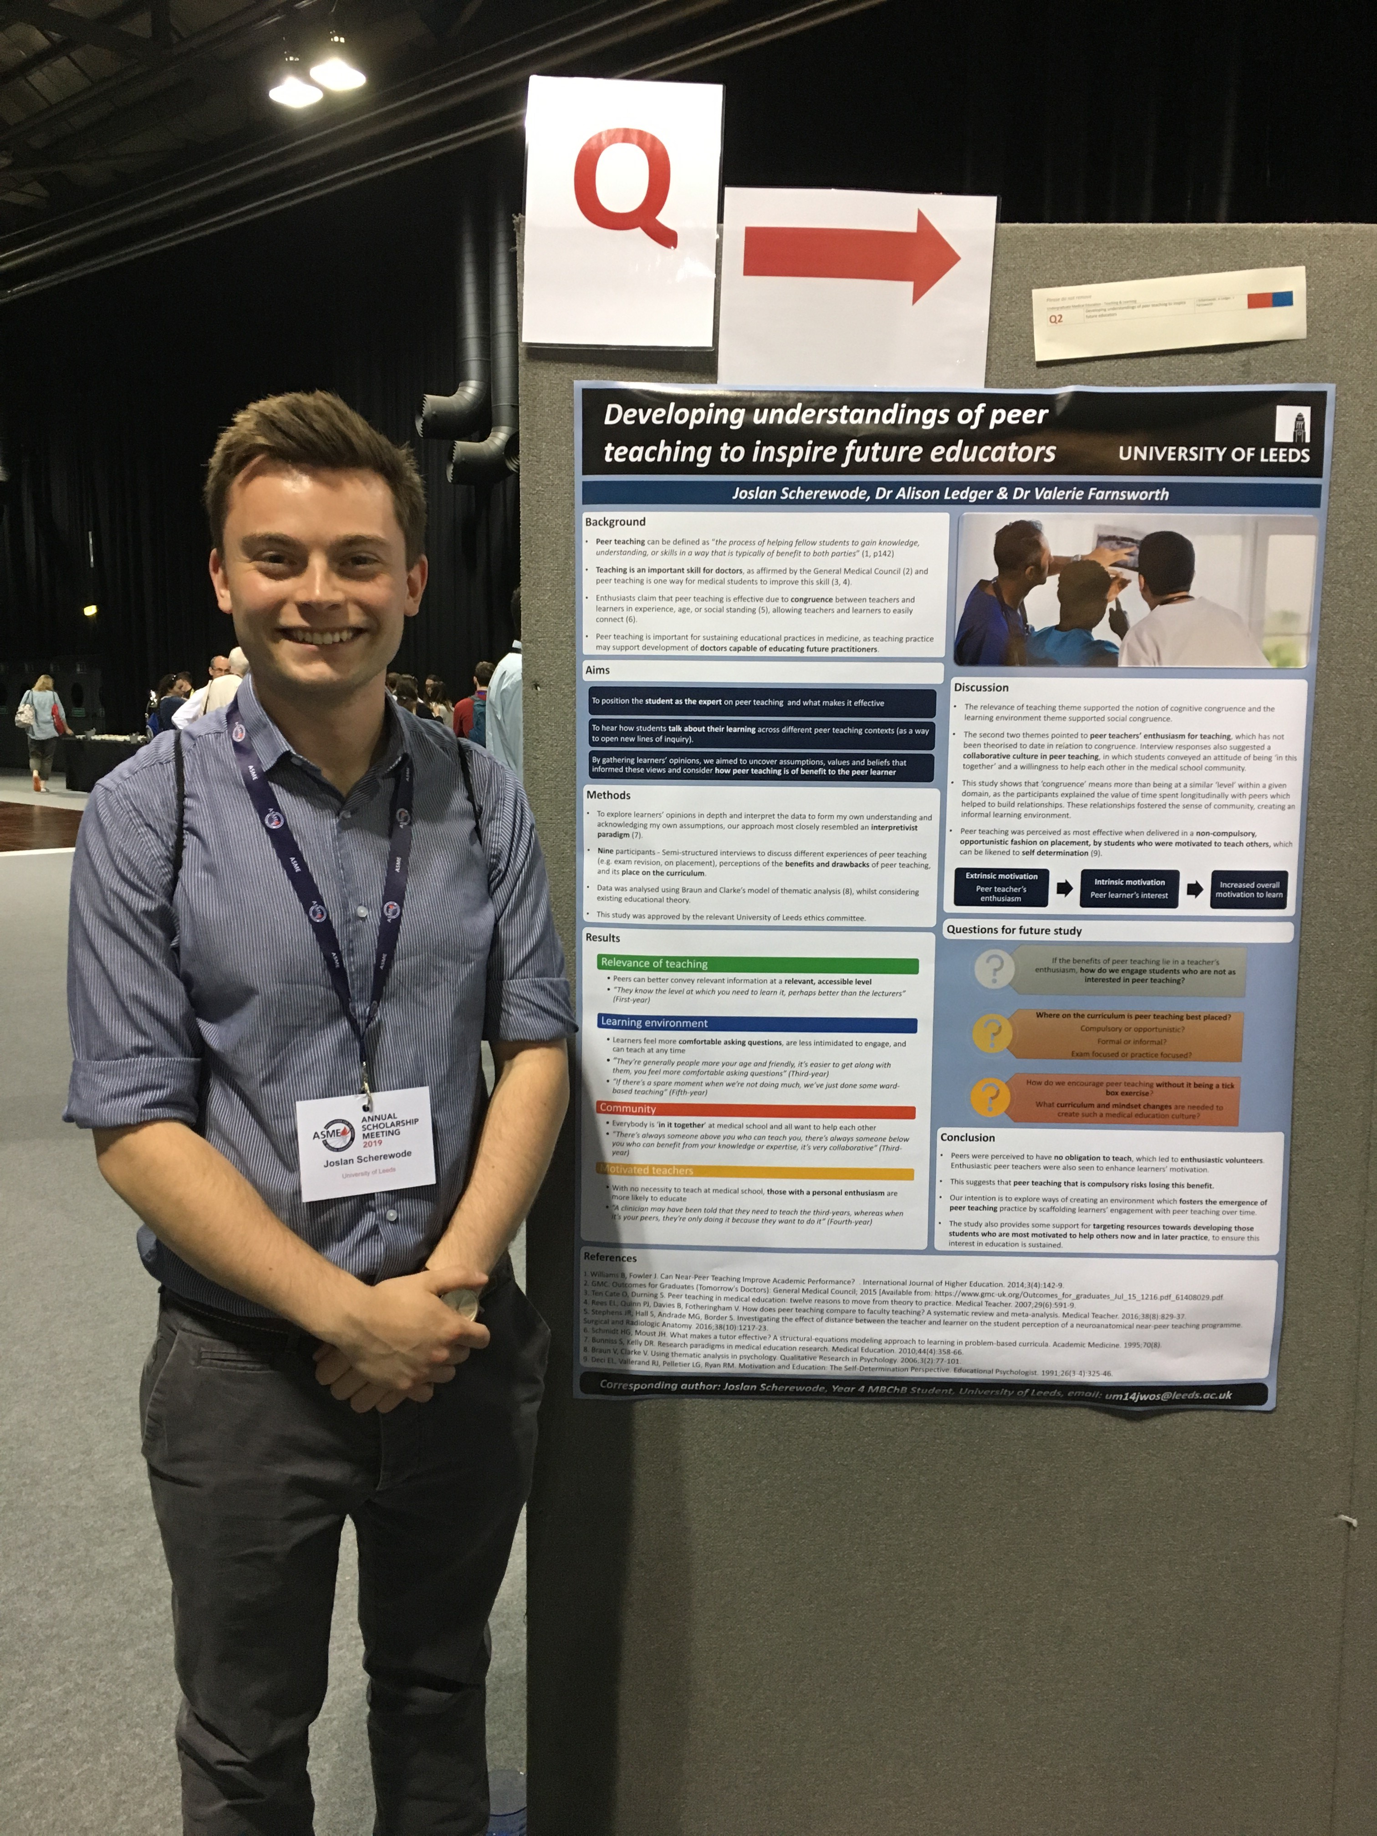
Possibility of presentations and prizes

Slide 10
Scholarships (https://medicinehealth.leeds.ac.uk/directory/4/scholarships )
National awards
Awards based on academic performance
Footsteps Funding

Slide 11
Representing a school and/or faculty
Take Home Messages
Intercalation offers you the chance to:
Broaden your knowledge
Develop your research skills
Gain a competitive edge in applying for clinical posts

Slide 12
Applications close
Sunday 26th January 2020
Further questions?
medicinehealth.leeds.ac.uk/medicine-intercalation
Email: intercalate@leeds.ac.uk
For Finance queries
Email: funding@leeds.ac.uk Entitled Intercalation
Cc S.Allen@adm.leeds.ac.uk

